Slide 1
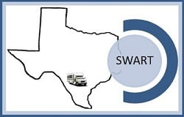
2020 Census Road Trip
Get Ready to travel with us.
To our outstanding and marvelous counties:
Dimmit Maverick
Edwards Real
Kinney Uvalde
La Salle Zavala
All material used is credited only to its rightful owner and have copy rights.
©
®
℗

Slide 2
2020 Census Road Trip
Our area is composed of what is considered rural and very rural counties that boarder Mexico in the south and is part of the Hill Country in the North.
The region’s primary industry is farm & ranch as well as retail Four of the southern counties of the region are impacted by the Eagle Ford Shale while the remaining counties are impacted by the Midland Oil Shale.
Although the region was once primarily populated with migrant workers, due to the mechanization of farms, the area now has a large population of oil and gas field workers.
The region also is unique for a rural area, regarding the provision of higher education due to the vast programs and degrees offered by the Southwest Texas Junior College and the Sul Ross State University Rio Grande College. SWTJC is one of the top 10 Jr. Colleges in the nation. This allows for those in the region to set and acquire higher educational goals.

Slide 3
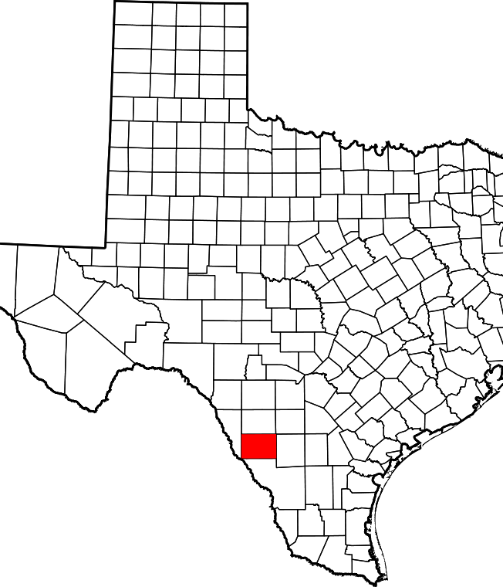
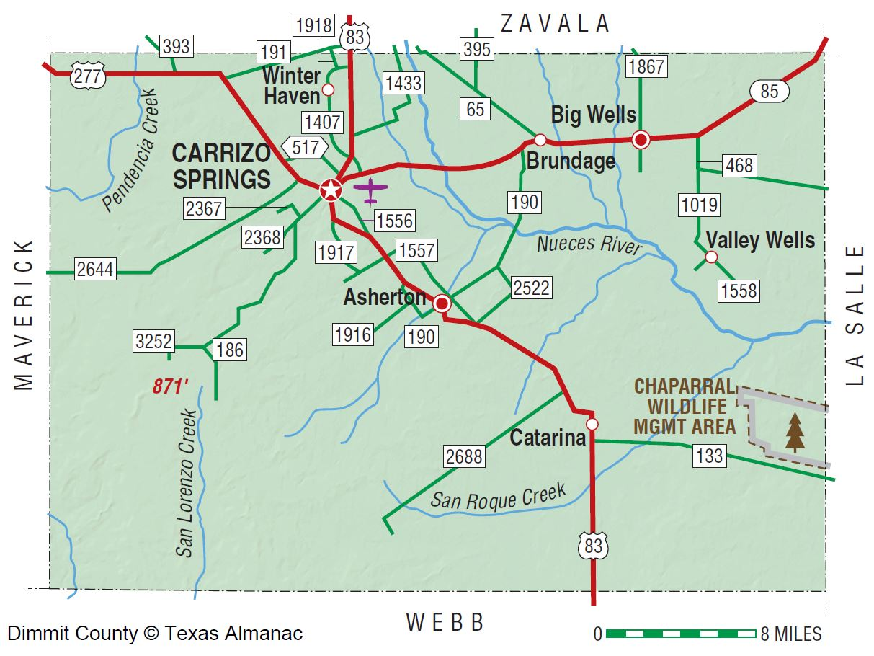
Dimmit County Texas
Asherton
Big Wells
Brundage
Carrizo Springs
Catarina
Union Valley
Valley Wells
inter Haven
Carrizo Springs is the oldest town in Dimmit County; it was founded in 1865 by a group of fifteen families from Atascosa County, led by Levi English, who had visited the area earlier. A second group of settlers arrived from Goliad about two years later.
The 1884 Dimmit County Courthouse

Slide 4
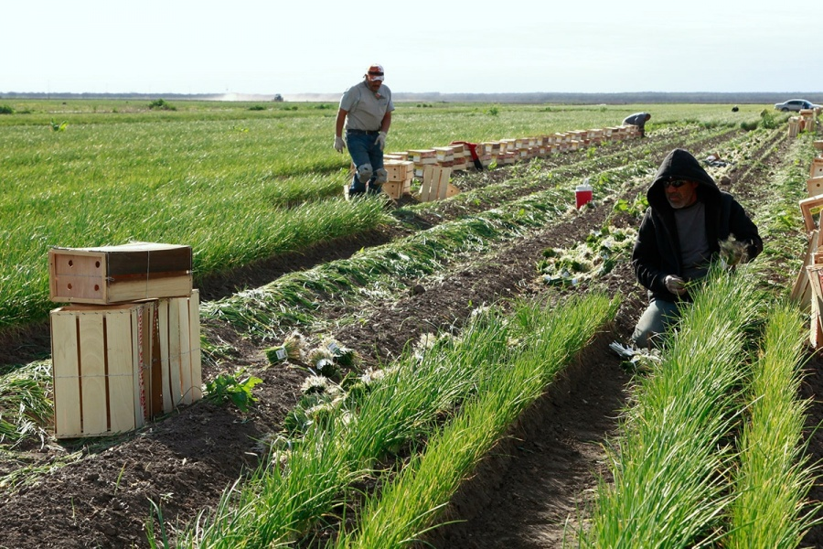
Dimmit County Texas
Dixondale Farms has been providing onion plants since 1913. Family farmed in Carrizo Springs, TX for 106 years. A Short History of Dixondale Farms As told by Jeanie Martin Frasier In the early 1900's, my great-grandfather, John Mabson McClendon, moved his family to Dimmit County from a small Central Texas town called Pancake, TX.
He began farming an area north of town called the Dixondale addition in the Wintergarden area. All of us at Dixondale Farms still live in that section of town as neighbors. John's son, Earl, who was 15 at the time, began farming with his father, growing onion transplants and sending them by train to farmers throughout the United States.

Slide 5
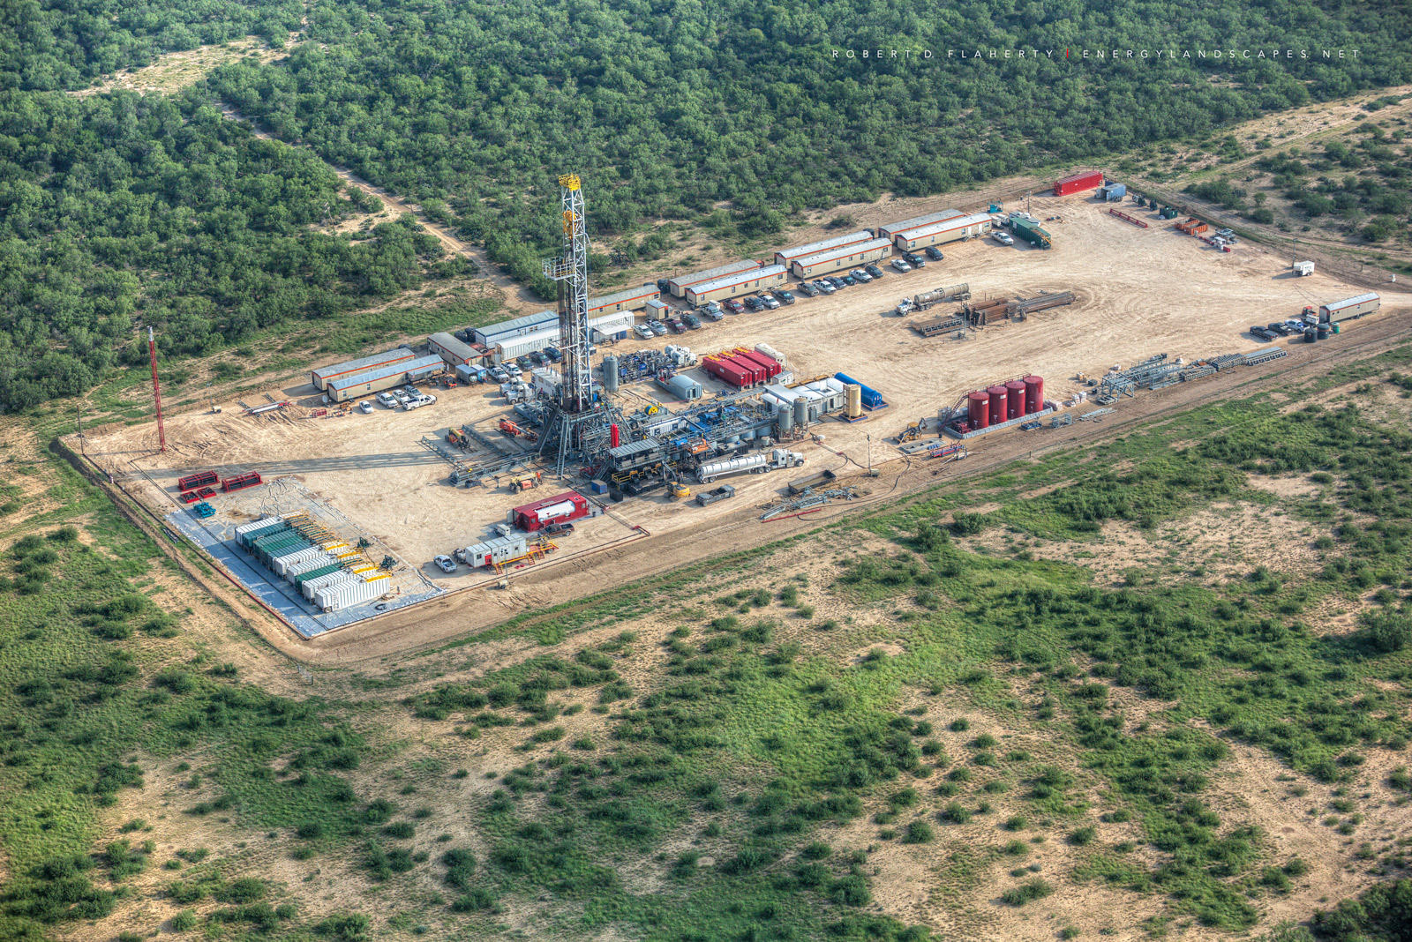
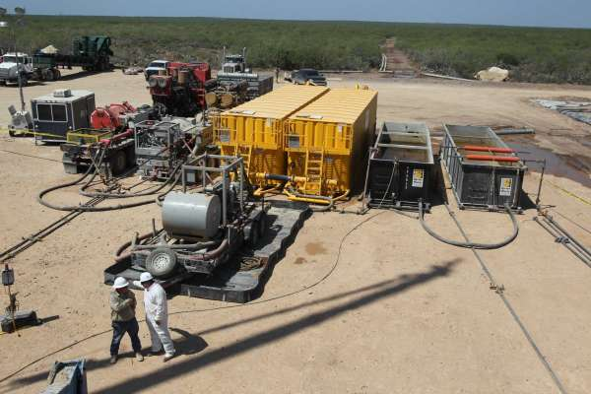
Dimmit County Texas
By Molly Hennessy-Fiske
Feb. 15, 2014
CARRIZO SPRINGS, Texas — Just a few years ago this was a sleepy town of 5,600, and people eked out a living from the land. They farmed, worked ranches and leased their property to hunters to make a few dollars.
Now, an oil and gas boom is transforming the economy of south Texas, turning Carrizo Springs into a busy city of at least 40,000.

Slide 6
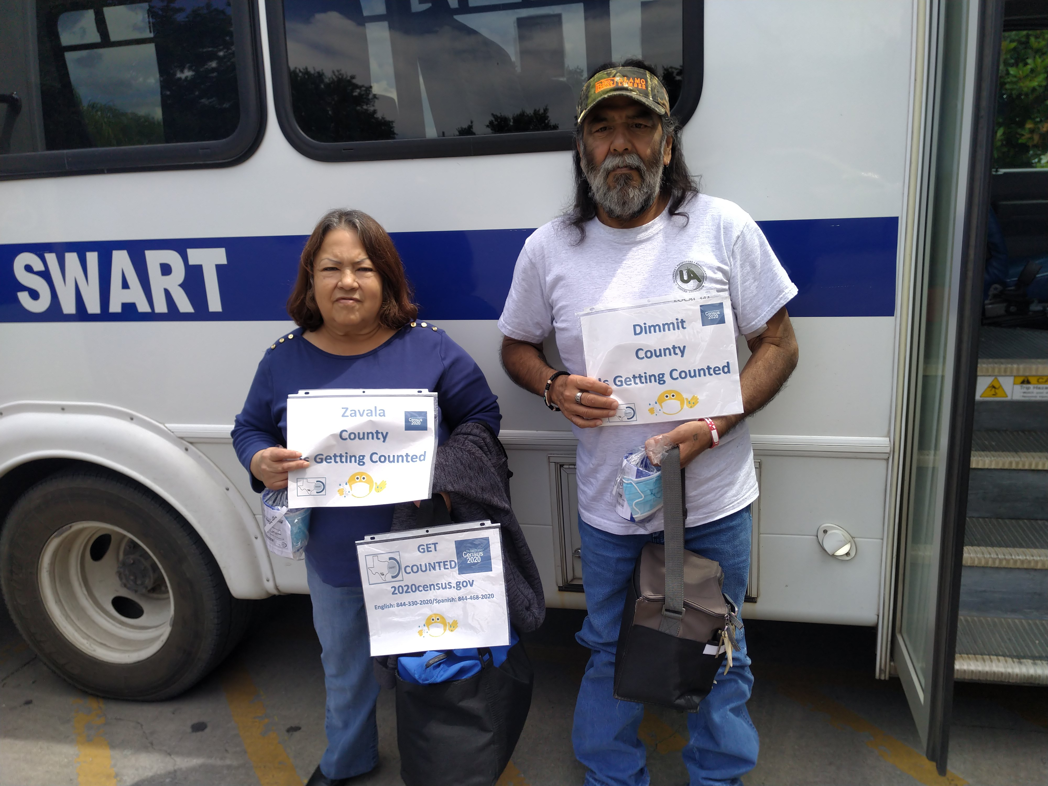
Dimmit County Texas
One part of SWART Outreach component is to inform and assist our clients with the 2020 Census count. Here we have our Dimmit County clients.
Special Thanks,
You to all our SWART Vehicle Operators for their assistance in distribution of the 2020 Census information to our passengers.

Slide 7
Dimmit County Texas
The following Agencies from Dimmit County allowed SWART to distribute or present the 2020 Census to their clients.
Fresenius Kidney Care Carrizo Springs
Asherton Elementary School District
Kids Are First Children Day Care
Carrizo Springs Postal Office
La Paloma Adult Day Care Center
Dimmit Regional Hospital
Carrizo Springs Middle Rio Grande Workforce
Cleo’s Laundromat
Botello’s Auto Sales
Carrizo Springs ISD
Dimmit County Department
City of Carrizo Springs
Carrizo Springs Avance Day Care Center
Catarina Catholic Church
Carrizo Springs Public Library

Slide 8
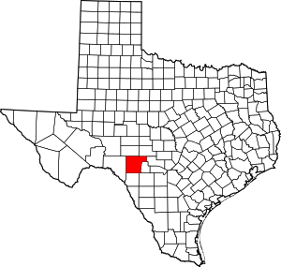
Edwards County (Rocksprings, Barksdale, Carta Valley & Hackberry)
Edwards County is a county located on the Edwards Plateau in the U.S. state of Texas. As of the 2010 census, its population was 2,002. The county seat is Rocksprings. The county was created in 1858 and later organized in 1883.
The town got its name from the natural Rock Springs that bubble in the area. The Devil’s Sinkhole is seven miles north of town. The Devil’s Sinkhole, a natural bat habitat, is home to the Mexican free-tailed bat. The cavern has said to be the largest single-chamber cavern in Texas. At sundown, visitors can witness over 3 million bats emerging from the surface.

Slide 9
Edwards County (Rocksprings, Barksdale, Carta Valley & Hackberry)
The following Agencies from Edwards County allowed SWART to distribute or present the 2020 Census to their clients.
City of Rocksprings
Edwards County Clerk Office
Rocksprings Avance Day Care Center
Rocksprings ISD
Rocksprings Park and Community Center

Slide 10
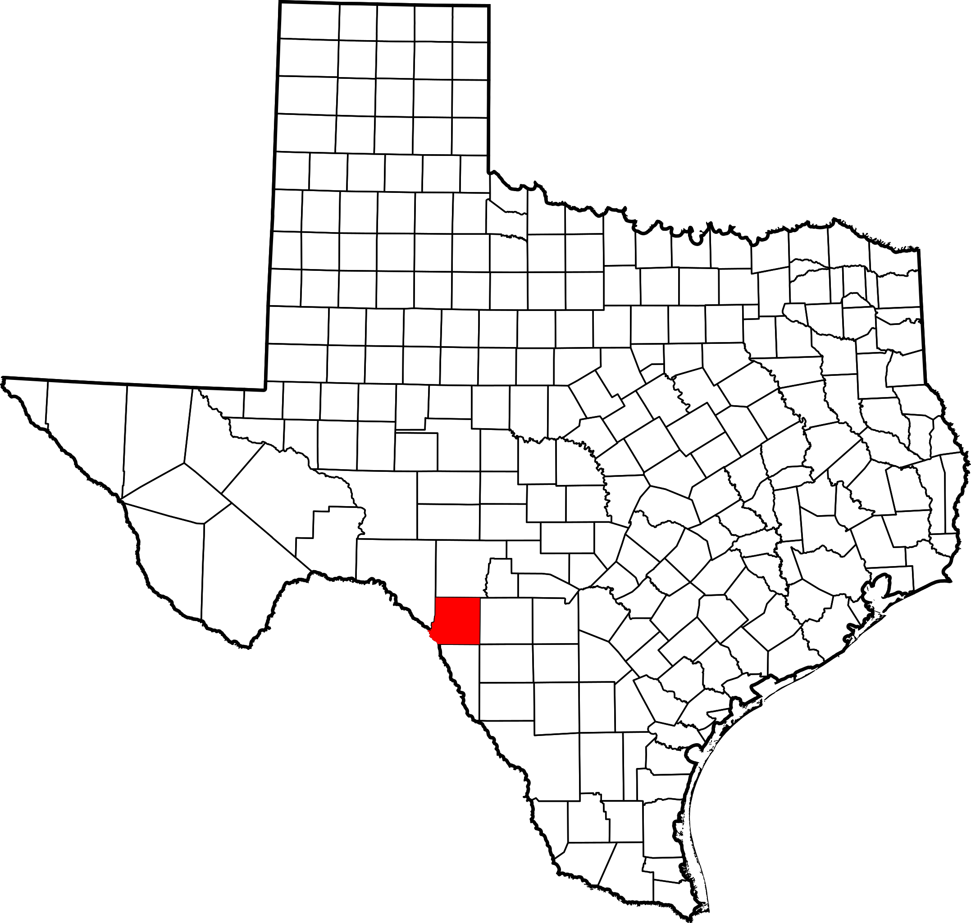
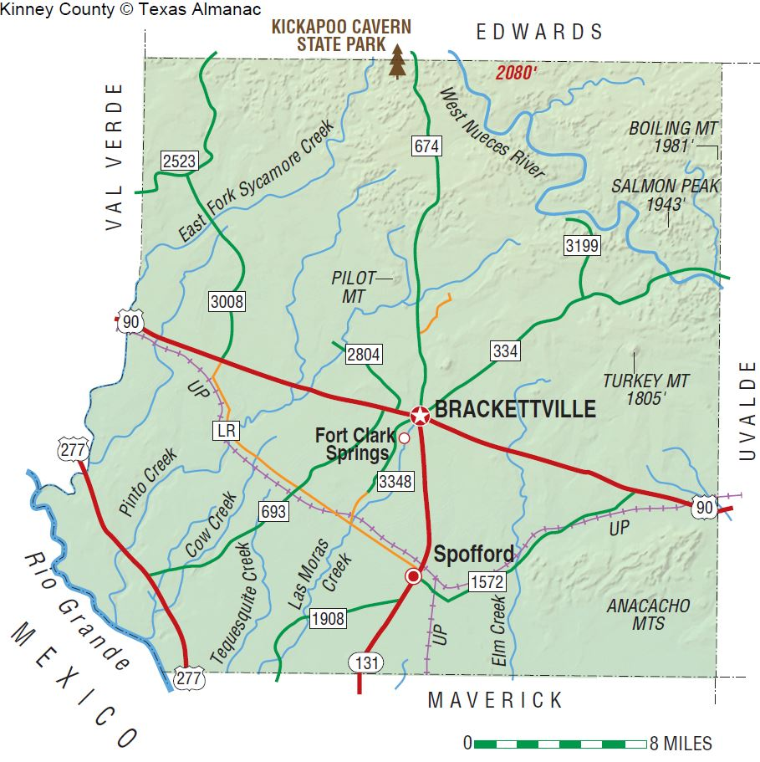
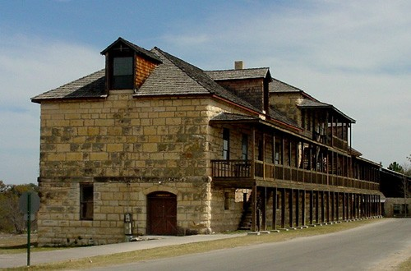
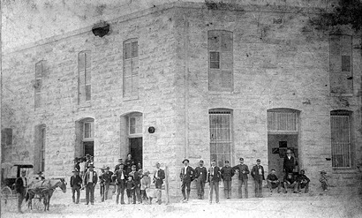
Kinney County (Brackettville, Fort Clark Spring & Spofford)
In 1852, the town was named after Oscar Brackett who was a sutler to Fort Clark. The town started around his store around 1852 and was first called Brackett (as it is today by residents).
A former Cavalry Post. Established in 1852, deactivated in 1947. Today "Fort Clark Springs", a private resort. The spacious spring-fed pool (Las Moras Springs) a major attraction. The museum and many well-preserved buildings make it easy to imagine life here in the 1860s. The Post Theater remains as it was in 1946, the year the Post was decommissioned.

Slide 11
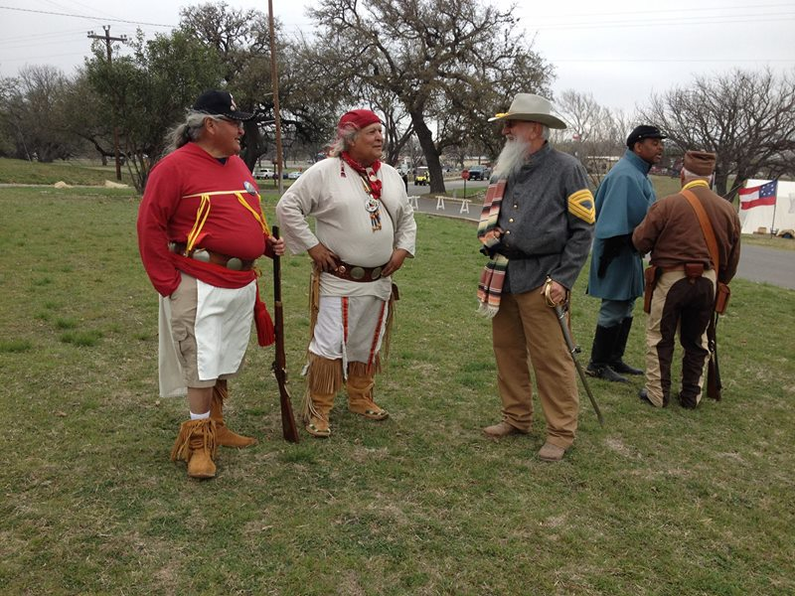
Kinney County (Brackettville, Fort Clark Spring & Spofford)
For more than 40 years, Fort Clark Days has taken place at Fort Clark Springs in Brackettville, Texas. More than 100 living historians demonstrate skills from the past and educate our visitors about the history of southwest Texas. In addition to our living historians, we have arts & crafts and food vendors.

Slide 12
Kinney County (Brackettville, Fort Clark Spring & Spofford)
The following Agencies from Kinney County allowed SWART to distribute or present the 2020 Census to their clients.
Brackettville H.O.P.E. Center
Brackettville Postal Office
Kinney County Court House
Kinney County Chamber of Commerce
Brackettville Library
Brackettville Department of Aging
Fort Clark Springs
Brackettville ISD
Brackettville Nutrition Center

Slide 13
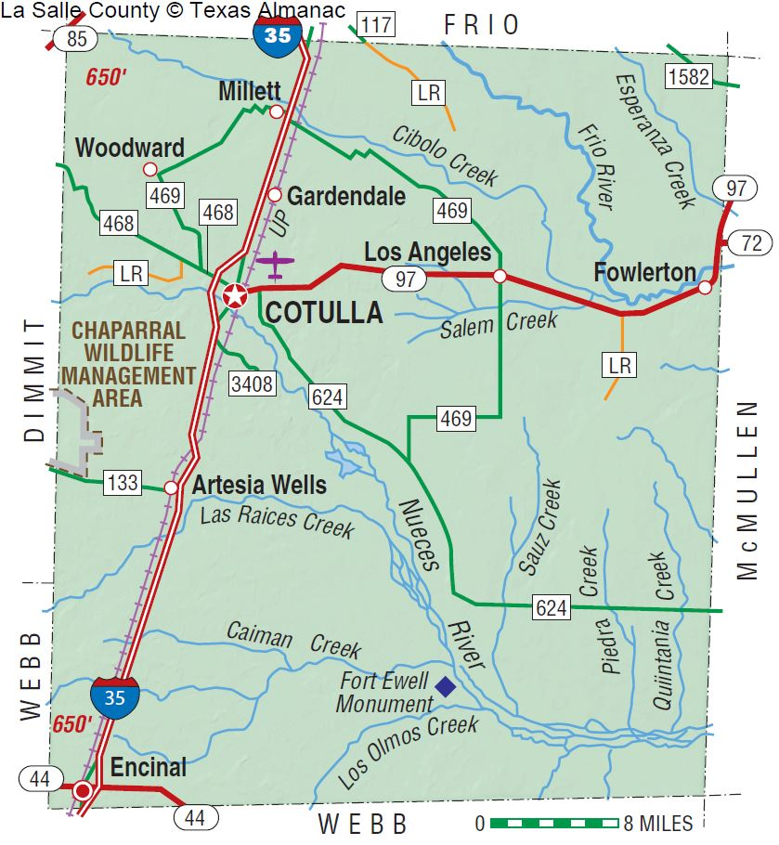
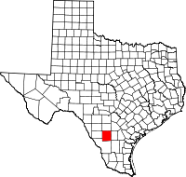
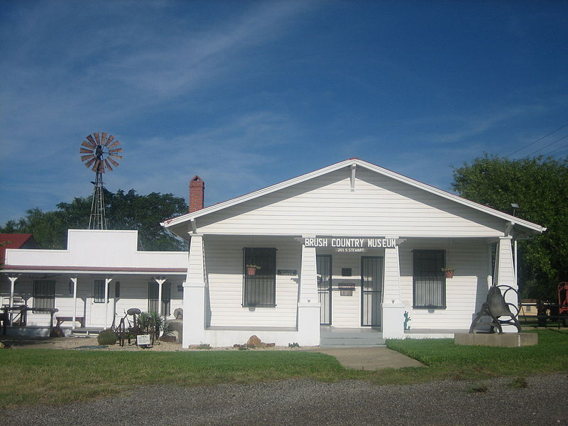
La Salle County (Cotulla TX – Encinal TX)
The immigrant Joseph Cotulla, who was reared in Silesia, then a part of Prussia, migrated to the United States in the 1850s. He joined the Union Army in Brownsville, Texas. He lived in Atascosa County but arrived in La Salle County in 1868^{[7]} to establish what became a large ranching area In 1881, Cotulla donated 120 acres of his land to the railroad, and in 1882, a depot was constructed there. In 1883, the town was granted a post office. The same year, Cotulla became the county seat by special election.^{[8]} operation
The Brush Country Museum in Cotulla preserves regional history.
Cotulla Historic District sign downtown (erected 2013)

Slide 14
La Salle County (Cotulla TX – Encinal TX)
The following Agencies from La Salle allowed SWART to distribute or present the 2020 Census to their clients.
Cotulla Kids Are First Children Day Care
Cotulla Postal Office
La Salle County Chamber of Commerce
South Texas Rural Health Services
Cotulla Workforce Center
Cotulla Texas ISD
La Salle County Department
City of Cotulla Texas

Slide 15
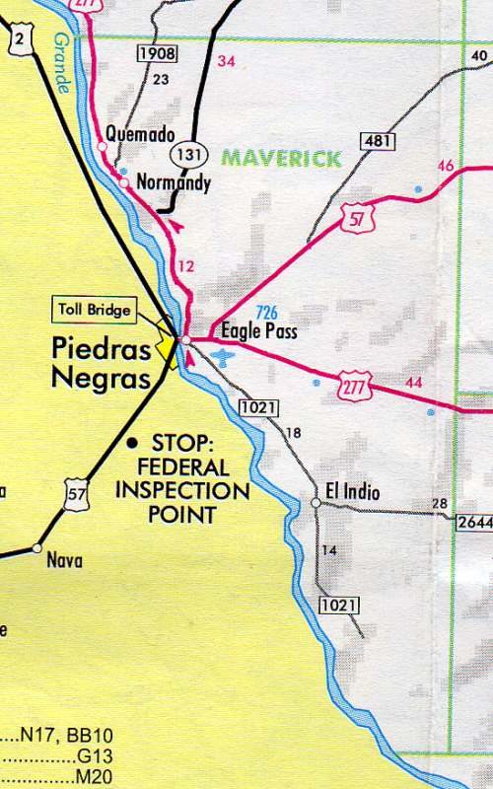
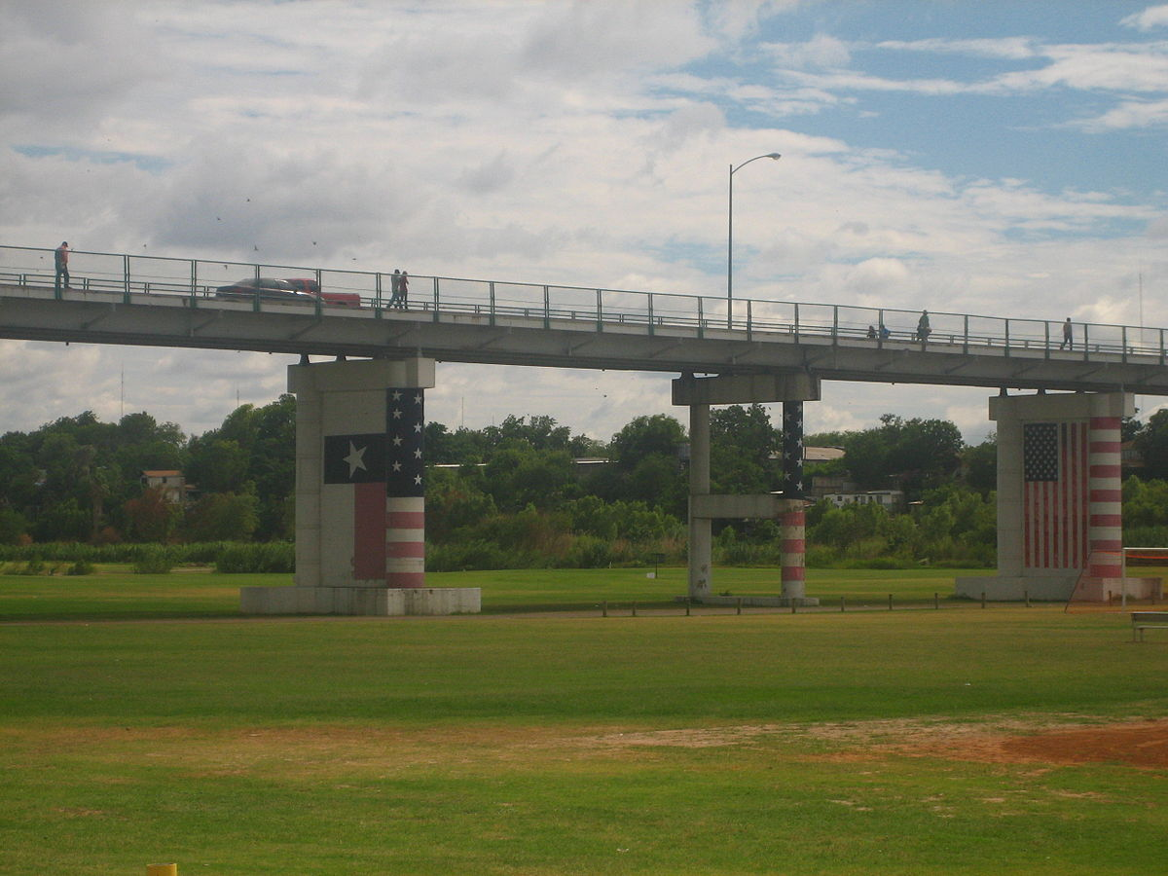
Maverick County Eagle Pass, Quemado, Normandy & El Indio
Eagle Pass is a city in and the county seat of Maverick County in the U.S. state of Texas. The population was 26,255 as of the 2010 census. Eagle Pass borders the city of Piedras Negras, Coahuila, Mexico, which is to the southwest and across the Rio Grande. The Eagle Pass-Piedras Negras Metropolitan Area is one of six binational metropolitan areas along the United States-Mexican border.
Eagle Pass boarder crossing to Piedras Negras Mexico

Slide 16
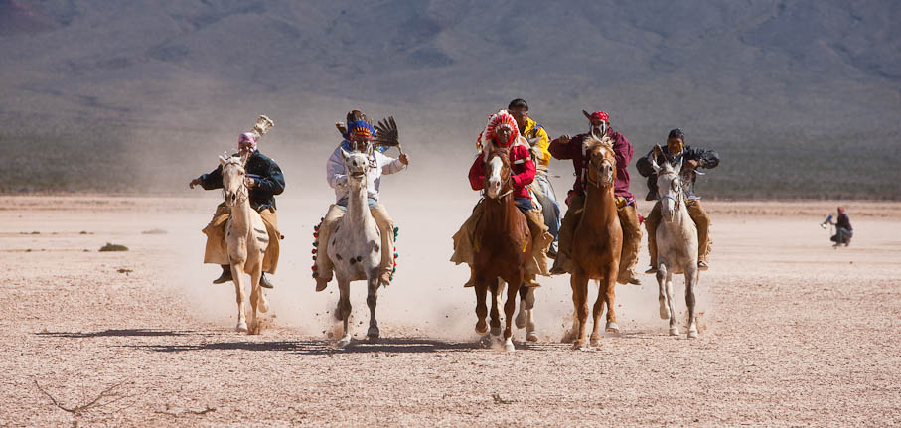
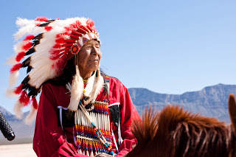
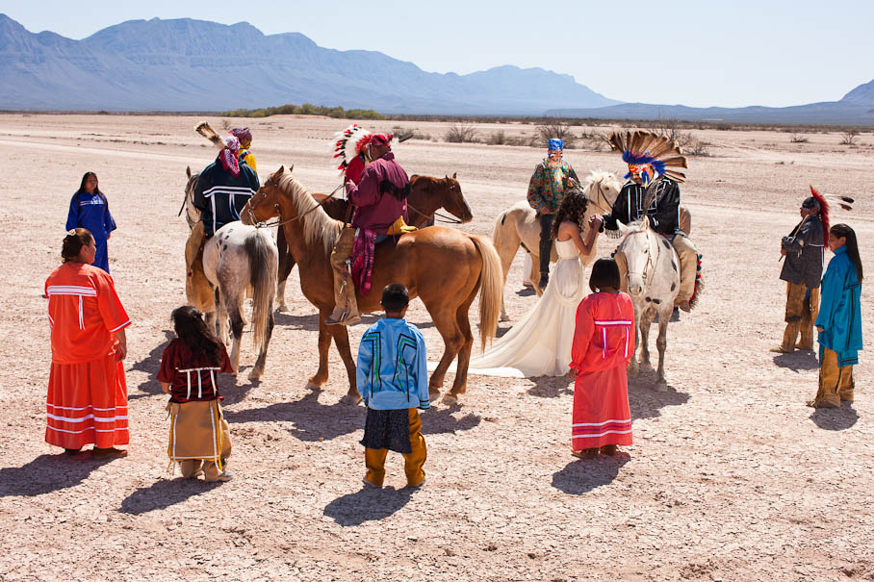
Maverick County
The Kickapoo Traditional Tribe of Texas (KTTT), formerly known as the Texas Band of Traditional Kickapoo, is one of three federally recognized Tribes of Kickapoo people. The KTTT has a current population of 960 enrolled members and was officially recognized by the Texas Indian Commission in 1977. The KTTT Reservation is located by the Rio Grande on the US-Mexico border in western Maverick County. It is just south of Eagle Pass, Texas as part of the Rosita Valley community.

Slide 17
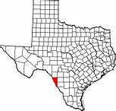
Maverick County
The following Agencies from Maverick County allowed SWART to distribute or present the 2020 Census to their clients.
Fresenius Kidney Care Center Eagle Pass
DaVita Kidney Care Center Eagle Pass
Eagle Pass School District
Kids Are First Children Day Care
Eagle Pass Postal Office
TLC Adult Day Care Center
Willow Creek Adult Day Care Center
Fort Duncan Maverick Regional Hospital
Eagle Pass Workforce Center
Eagle Pass ISD
Maverick County Department
City of Eagle Pass
Eagle Pass Avance Day Care Center
Eagle Pass Methodist Health Ministries

Slide 18
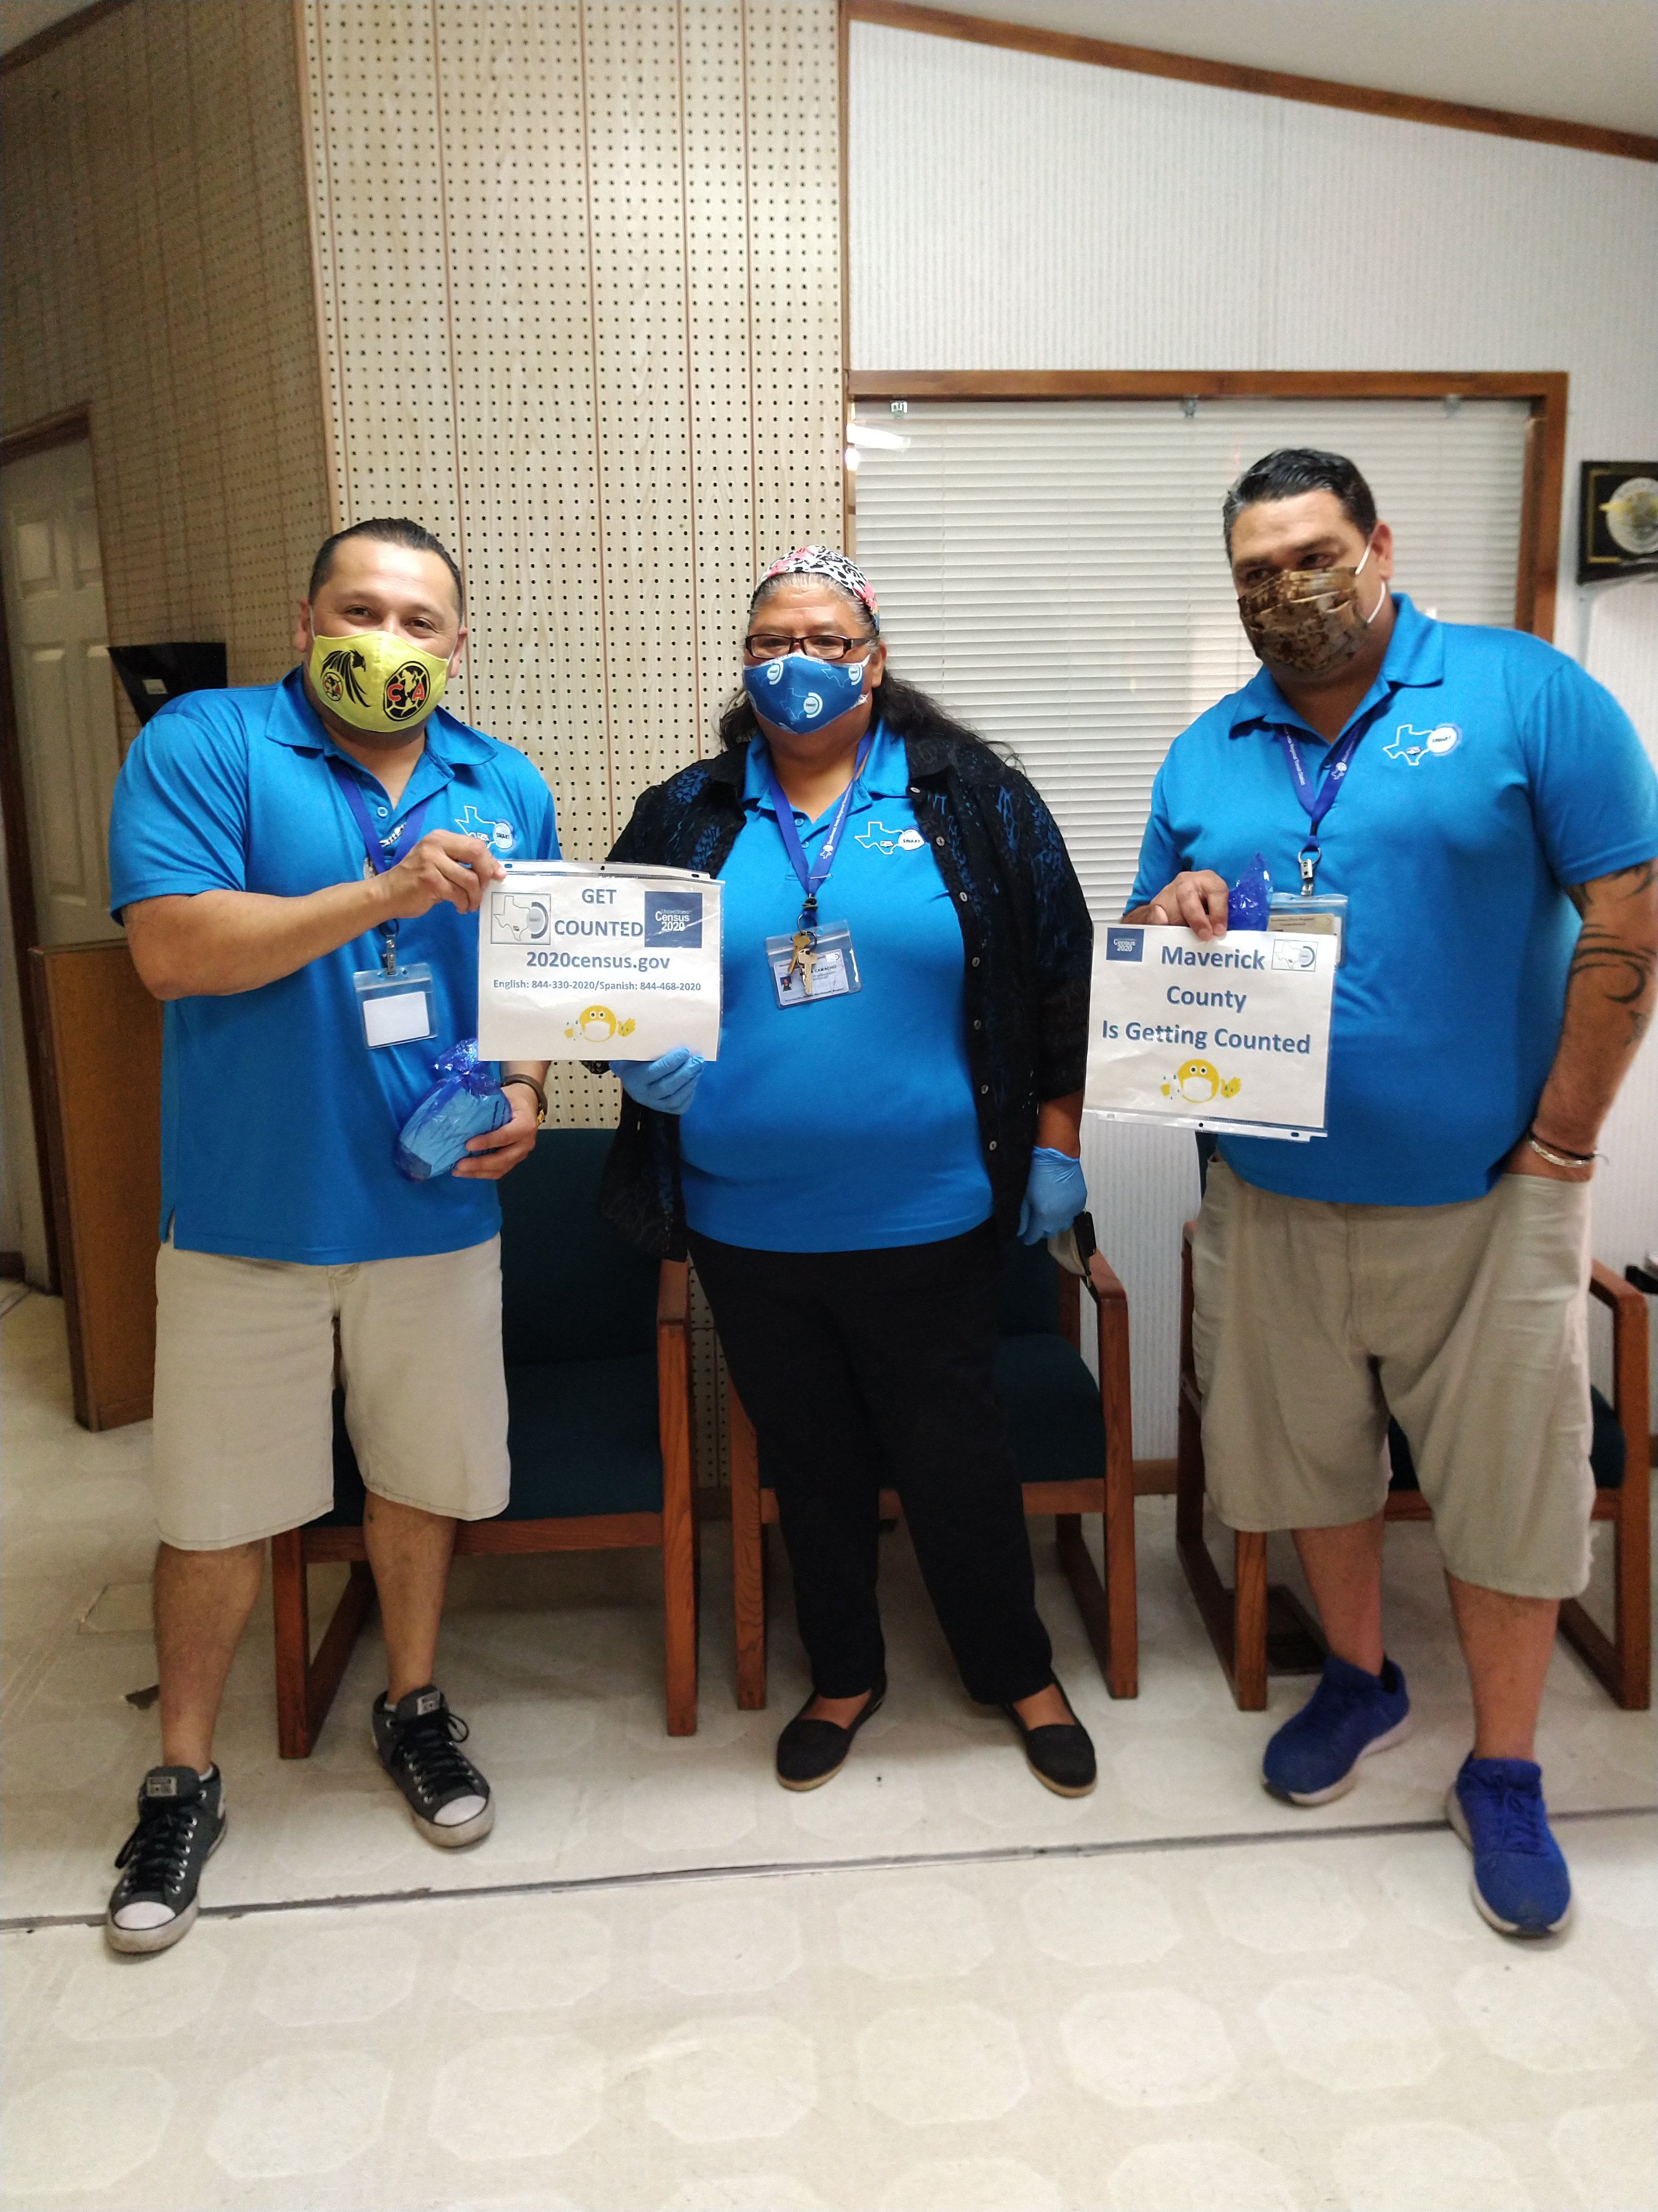
Maverick County
One part of SWART Outreach component is to inform and assist our clients with the 2020 Census count. Here we have our Maverick County clients. Vehicle Operators Blanca Garza, Manuel Cervantez and Rolando De Luna
Special Thanks,
You to all our SWART Vehicle Operators for their assistance in distribution of the 2020 Census information to our passengers.

Slide 19
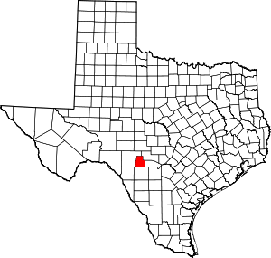
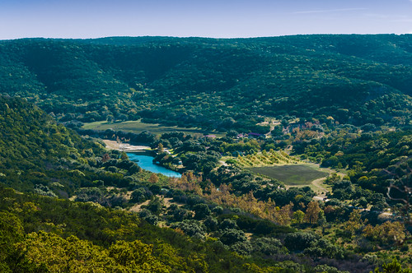
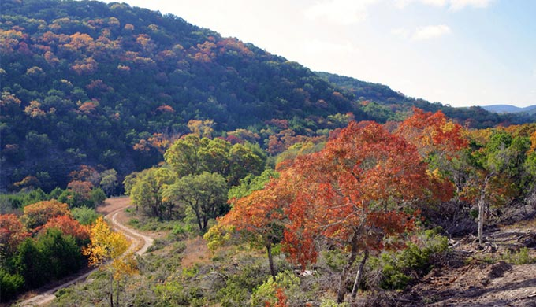
Real County Camp Wood, Leakey
Camp Wood is on the Nueces River at the intersection of Farm Road 337 and State Highway 55, just below Camp Wood Creek in far southwestern Real County. The settlement was founded in 1920 by workers of the Uvalde Cedar Company for the purpose of exploiting the abundant cedar in the area.
The area is home to over 200 different bird species. The annual fair holds bow hunting contests. One of the most beautiful scenic drives in Texas Hill Country is the drive from Camp Wood to Medina.

Slide 20
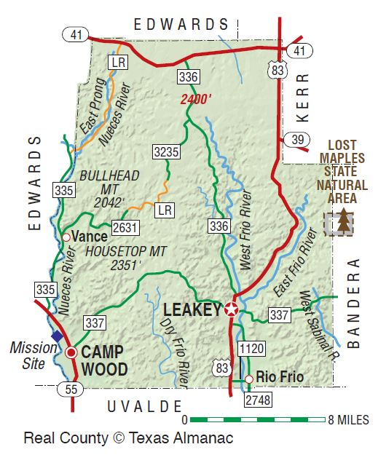
Real County Camp Wood, Leakey
The following Agencies from Real County allowed SWART to distribute or present the 2020 Census to their clients.
City of Leakey
Real County Office
Real County Library Leakey
Camp Wood Library

Slide 21
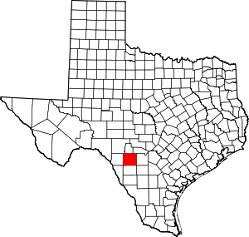
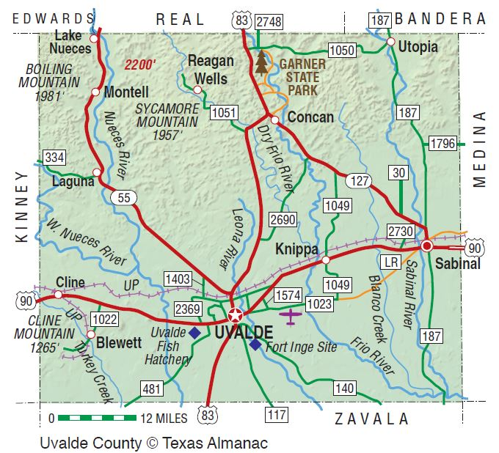
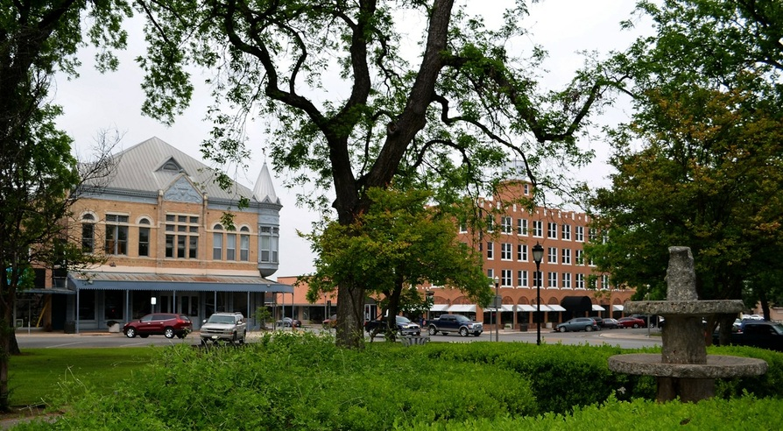
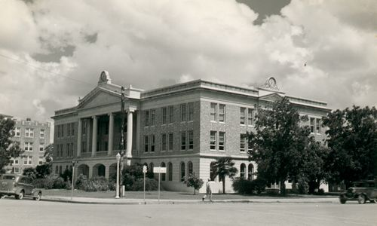
Uvalde County Concan, Knippa, Sabinal, Utopia & Uvalde
The Opera House on the left and the Kincaid Hotel on the right, at the intersection of North and Getty Streets on the square
Uvalde County's 1927 Courthouse as it appeared in 1939 Photo courtesy TxDOT

Slide 22
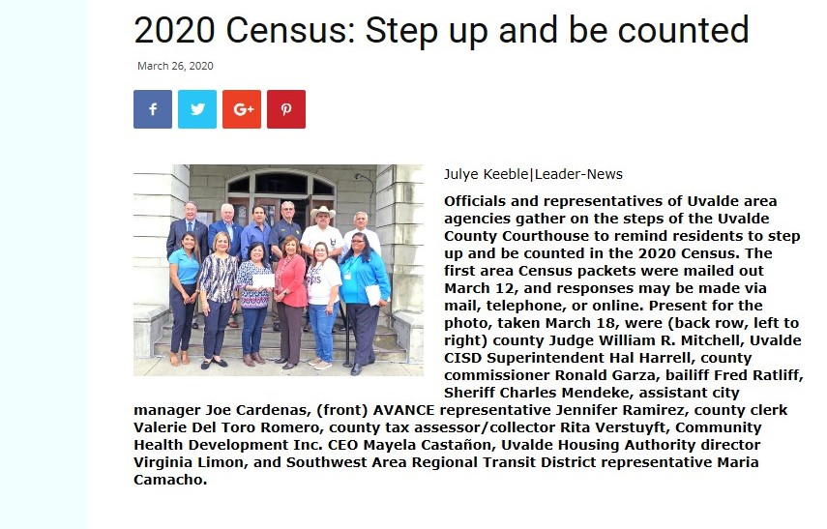
Uvalde County Concan, Knippa, Sabinal, Utopia & Uvalde

Slide 23
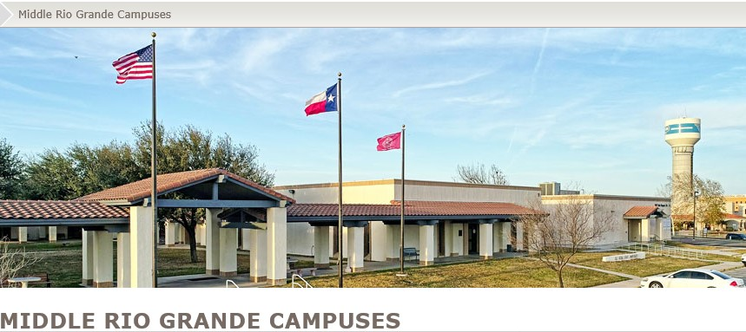
Uvalde County Concan, Knippa, Sabinal, Utopia & Uvalde

Slide 24
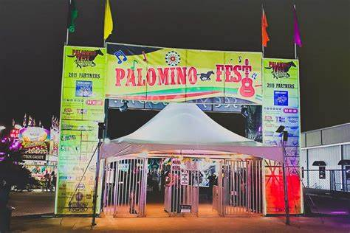
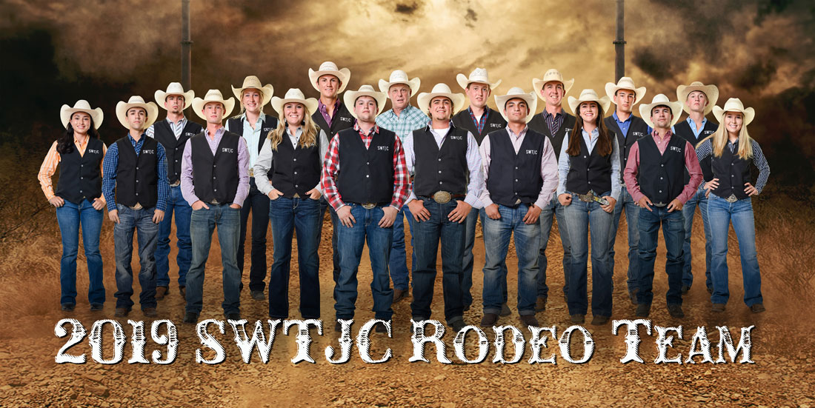
Uvalde County Concan, Knippa, Sabinal, Utopia & Uvalde

Slide 25
Uvalde County Concan, Knippa, Sabinal, Utopia & Uvalde
The following Agencies from Uvalde County allowed SWART to distribute or present the 2020 Census to their clients.
DaVita Kidney Care Center Uvalde
Uvalde TX Postal Office
La Paloma Adult Day Care Center
Our Health/Nuestro Centro de Salud
Uvalde Middle Rio Grande Workforce
Uvalde TX ISD
Uvalde County Department
City of Uvalde Texas
Uvalde Avance Day Care Center
Catarina Catholic Church
El Progreso Public Library
Knippa TX Postal Office
Sabinal TX Postal Office
Uvalde Housing Authority
Action Community Service
Leona Apartments
Granada Apartments
Monarch Estates
Methodist Health Care Ministries
Uvalde Nutrition Center

Slide 26
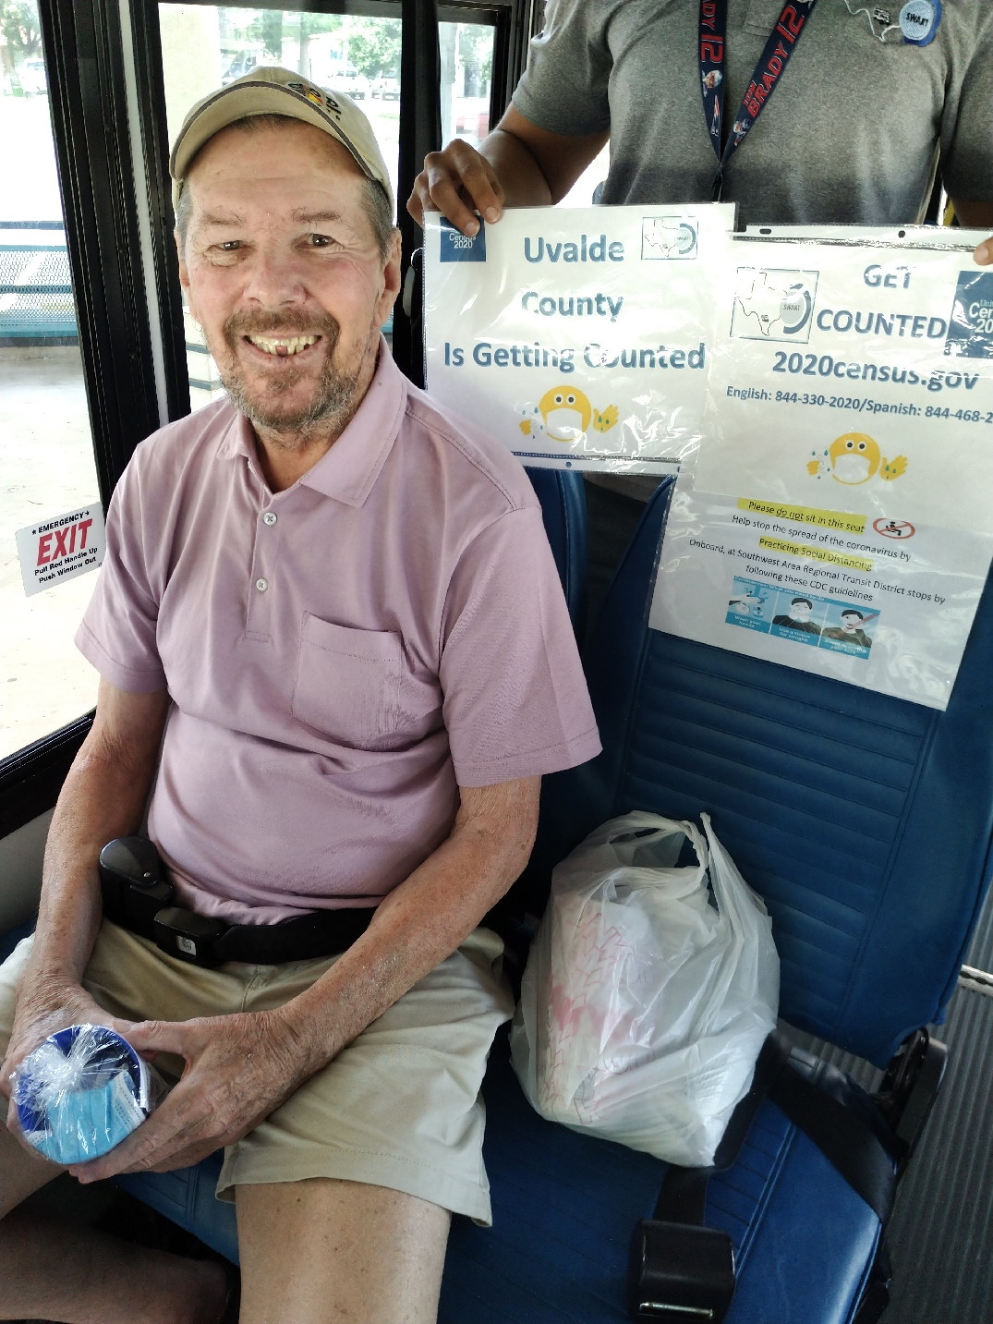
Uvalde County Concan, Knippa, Sabinal, Utopia & Uvalde
One part of SWART Outreach component is to inform and assist our clients with the 2020 Census count. Here we have our Uvalde County clients. Dispatch Operators Claudia Veloz and Erika Uriegas
Special Thanks,
You to all our SWART Dispatch Operators for their assistance in distribution of the 2020 Census information to our passengers.

Slide 27
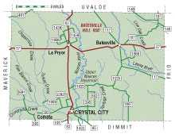
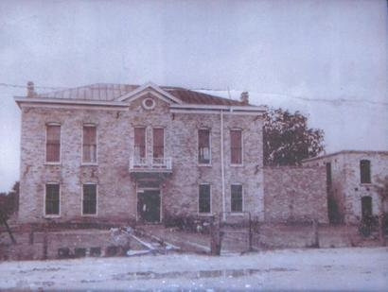
Zavala County La Pryor, Batesville, Crystal City
BATESVILLE, TEXAS (Zavala County). Batesville is on the Leona River at the intersection of U.S. Highway 57 and Farm Road 117, fifteen miles east of La Pryor in northeast Zavala County. The first settlers in the area were ranchers Mont Woodward in the mid-1860s and the Bates family around 1869. By 1870 the Bates brothers, Elijah, Felix, and Finis, had developed a large ranch in the area; it spawned the development of a small community known as Bates Ranch.
"This is a photo of a picture of the 1885 Zavala County courthouse (in Batesville) that hangs in the county clerk's office in the current courthouse." - Terry Jeanson, April 2007
The county built its first courthouse in Batesville in 1884, using mud from the Leona River to make bricks

Slide 28
Zavala County La Pryor, Batesville, Crystal City
Crystal City, the county seat of Zavala County, is at the intersection of U.S. Highway 83, Farm roads 393, 16, 1433, 65, and 582, and the Missouri Pacific Railroad, one mile north of the Dimmit county line in south central Zavala County. Two land developers, Carl F. Groos and E. J. Buckingham, developed the town in the early 1900s. In 1905 they purchased the 10,000-acre Cross S Ranch, sold off most of the land as farms, and platted the townsite of Crystal City, named for the clear artesian water of the area. The town received a post office in 1908, the same year the Crystal City and Uvalde Railway provided the first rail service to the community and the first school building was erected. Crystal City was incorporated in 1910

Slide 29
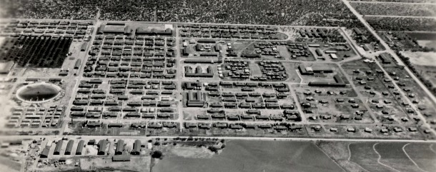
Zavala County La Pryor, Batesville, Crystal City
Crystal City Texas, Interment Camp
Housing all three Axis nationalities, Crystal City (Family) Internment Camp was intended to be populated by people of Japanese ancestry and their immediate families. However, on December 12, 1942, the camp’s first internees to arrive were a mix of German Americans and German Enemy Aliens. On February 12, 1943, the first group of Latin Americans arrived––also Germans––deported from Costa Rica. On March 17, 1943, the first group of Japanese American internees arrived. The Immigration and Naturalization (INS) planned to transfer all German internees to another camp, but the German spokesman asked camp officials if they could remain because their living conditions here were far better than at previous confinement sites they were held at.

Slide 30
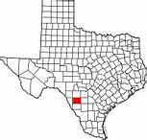
Zavala County La Pryor, Batesville, Crystal City
The following Agencies from Zavala County allowed SWART to distribute or present the 2020 Census to their clients.
Crystal City Postal Office
La Pryor Postal Office
Adult Day Care Center
Crystal City Centro de Salud
La Pryor Centro de Salud
Crystal City Middle Rio Grande Workforce
Crystal City TX ISD
Zavala County Department
City of Crystal City Texas
Crystal City TMC Day Care Center
Centro De Milagros Church
SWTJC Public Library
Crystal City Housing Authority
Action Community Service
Villa Hermosa Apartments
Crystal City Pharmacy
Crystal City WIC Office
Zavala County Nutrition Center

Slide 31
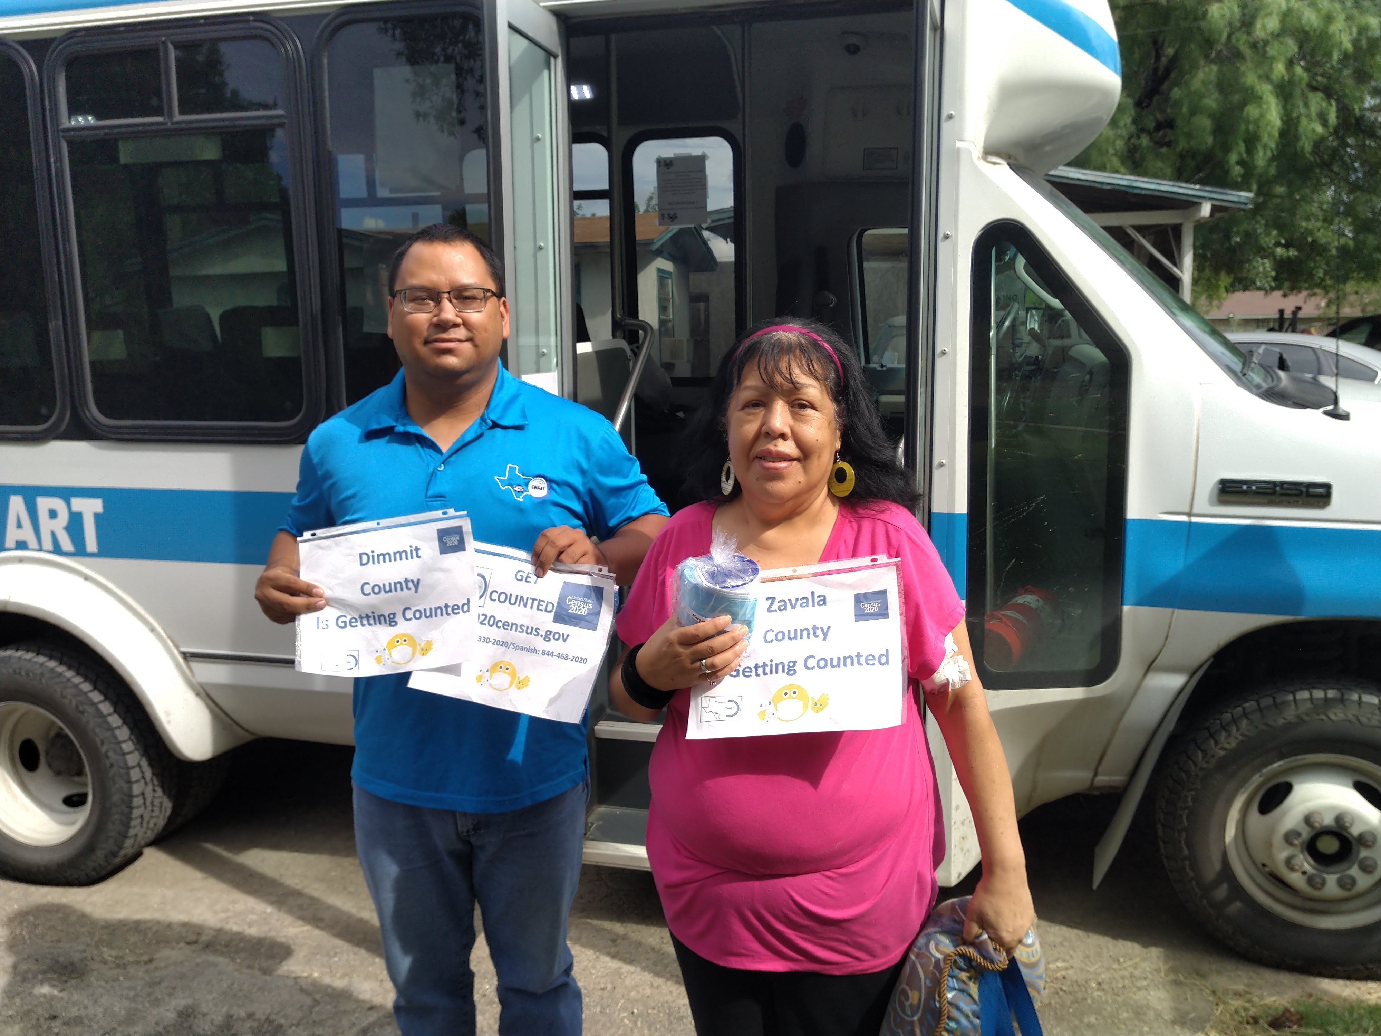
Zavala County La Pryor, Batesville, Crystal City
One part of SWART Outreach component is to inform and assist our clients with the 2020 Census count. Here we have our Zavala County clients. Vehicle Operators Robert Enriquez and Frankie Cisneros
Special Thanks,
You to all our SWART Vehicle Operators for their assistance in distribution of the 2020 Census information to our passengers.

Slide 32
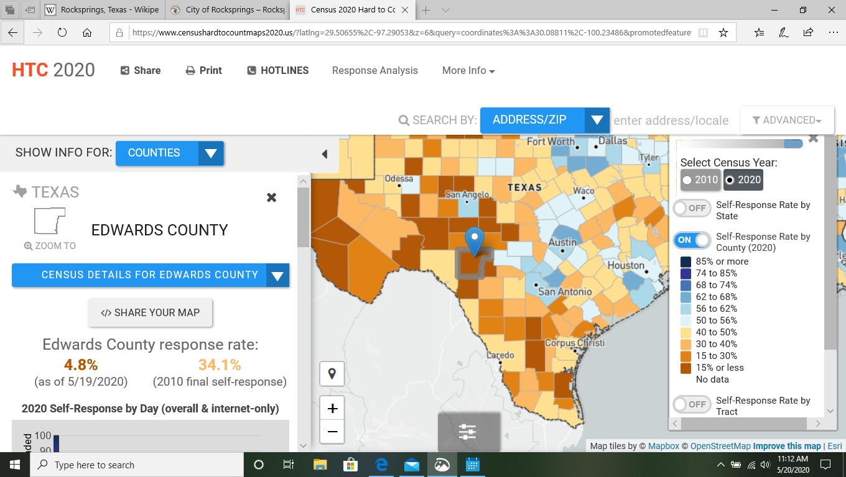
Social Media !!!
2020 Census Road Trip
Twitter
Facebook
LinkedIn
Messenger

Slide 33
GET
COUNTED
2020census.gov
English: 844-330-2020/Spanish: 844-468-2020 Special Thanks, to all the agencies involved in helping Texas citizens get counted. We Can Do It !! / Si Se Puede !!
2020 Census Road Trip

Slide 34
END of Road Trip. Next time You come this way Remember to stop and take in some history. Hope you enjoyed the trip. Thank You! Stay safe.
2020 Census Road Trip
©
℗
®
All material used is credited only to its rightful owner and have copy rights.

