Slide 1
State Efforts to Count All Kids
Part 1

Slide 2
Today’s Speakers
Cate Bohn, MPH, Research Policy Analyst, New York State Council on Children and Families
Stacy Lee, Managing Director Early Childhood Project Integration, Children Now
Whitney Tucker, MPH, Research Director, NC Child
Ashon McKenzie, Esq., Policy Director, Children's Defense Fund-Ohio
Cassie Davis, Research Analyst & State Policy Fellow, Center For Public Policy Priorities
| Research Director | NC Child

Slide 3
New York KIDS COUNT
February 12, 2019
Partnership for America’s Children Census 2020 webinar series

Slide 4
Notes:
In an effort to better understand the undercount of children, the Council organized parent focus groups for parents of young children. We spoke with parents who have children enrolled in Head Start and Migrant Head Start programs and individuals involved with Community Action Programs. Young parents in low-income communities were our target audience since many are unfamiliar with the census, less likely to complete the survey and tend to omit information about their young children. Focus group discussions were centered around identifying: (1) messages that persuade individuals to complete the census; (2) persons and organizations who are considered credible, trusted sources within their communities; and (3) how messages should be delivered so they will be visible to our intended audiences. The Council’s findings can be found here, https://www.ccf.ny.gov/files/8815/4688/4221/NYS_Census_Brief.pdf.

Slide 5
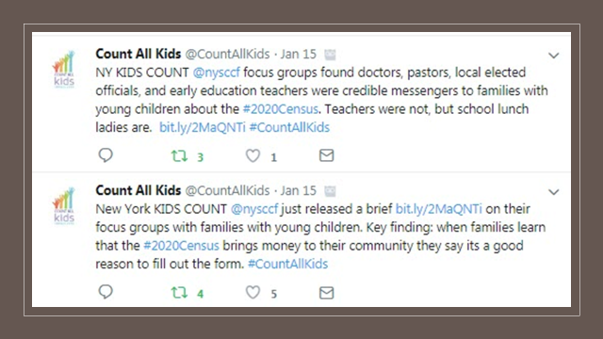
Notes:
Credible, trusted messengers: Commonly cited messengers who participants felt could be trusted included physicians, pastors, local elected officials and early education teachers. When asked about elementary school teachers or principals, participants recognized they were groups that would share the information as an obligation but did not necessarily live in the community so their commitment to that community was somewhat questioned. As one person stated, “it’s not personal for them.” While participants questioned the credibility of professional school staff, they suggested school lunch staff often lived in the community and would be preferred messengers. It was suggested that each community identify those individuals who were committed to helping disenfranchised members. An example of this was a formerly homeless woman who had made it her personal mission to help others who were experiencing challenges. Such individuals were convincing spokespersons because they knew about hardships and were finding ways to make improvements. Participants identified mayors as likely spokespersons to share information about the importance and benefit of completing the census. Mayors, unlike federal or state level representatives, were viewed as being closer to the community and more invested in what happened there, increasing their credibility. Overall, messengers need to be people who have relationships with members in the community

Slide 6
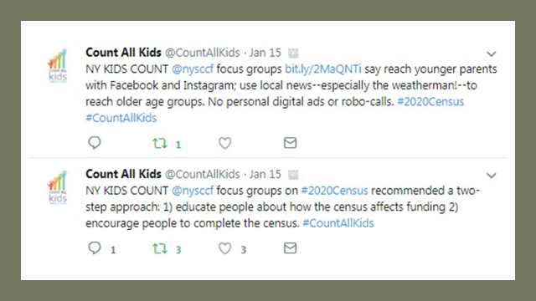
Notes:
Communication strategies: Focus group participants were surprised and pleased to know how census enumeration directly affects them. However, they also recognized they and others in their communities were often negotiating hectic, stressful circumstances in their lives, frequently holding down more than one job. Therefore, they felt it would require an extended period of messaging before people noticed the information; were adequately informed; and willing to complete the census. Many respondents suggested a two-step approach where the initial phase would focus on educating New Yorkers about the connection between census numbers and federal funding then the second phase would encourage people to complete and return the census. “Everyone listens to the weatherman—he’s the one they like too.” “Zuckerberg pops up to tell you about changes to Facebook; let him talk about the census.” “Do a video of this group right now and it will go viral—we’ll all send it out.” “Start by not talking about it. First tell people what it does for them; then ask them to complete it.” “Lots of people need these benefits so that will be good to know.” “Give them the facts because they don’t see the change. Tell them about things that the census funded in their community (e.g., bridge repairs).” Authors: Mary E. De Masi & Cate T. Bohn NY KIDS COUNT – Council on Children & Families; Funded in part by Annie E. Casey Foundation 3 Our participants, primarily in their 20s and 30s, commented several times that the sources they used to receive information differed from older family members. Young parents repeatedly identified Facebook (e.g., banner ads) and Instagram as mechanisms for getting their attention and local news broadcasts were primary sources used by older family members. “I don’t’ watch the news but my mother never misses it.” Multiple participants suggested “the weatherman” was the most likeable and best person for sharing messages about the census. All agreed that robo-calls were “annoying” and should be avoided; however, they had mixed opinions about mass text messages. The point was made that “anything personal, like something sent to my e-mail” would discourage participation in the census. Similarly, informational flyers placed in bills (e.g., electric, water, cable) would not promote responses. Paper forms available at the library were preferable to completing the census on one’s phone. Libraries, clinics, government offices (e.g., departments of social services, motor vehicles), food pantries, newspapers, news broadcasts, social media sources, schools, churches, billboards and community action programs were considered prime locations for distributing census materials.

Slide 7
Notes:
Inevitable barriers: An overarching theme present in each group was that “people are afraid to trust the government.” Experiences with child protective services, law enforcement, and national news events were cited as reasons for their wariness. This mistrust was everywhere—it was mentioned by citizens and non-citizens; members of all races; and in urban and rural communities. Participants were candid that they have issues in their homes that influence their decision to complete the census – family members who aren’t citizens; siblings who are temporarily residing with relatives without the landlord’s knowledge; and family members who are getting out of jail were examples given for why people would not want to share information. Assurances that census information was confidential and disclosure of information led to prison and high fines did not assuage participants’ concerns.

Slide 8
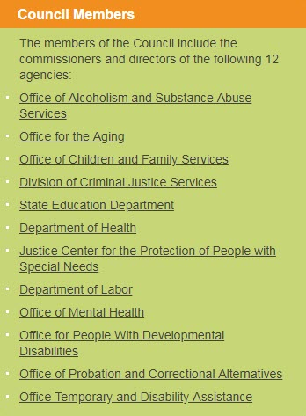
Unique place in state gov’t
Notes:
During its nearly 40-year history, the Council on Children and Families (Council) has served as a broker, innovator and change agent among the state's health, education and human services agencies. The unique value of the Council is its ability to provide a comprehensive, cross-systems perspective critical for the development and implementation of strategies impacting the availability, accessibility and quality of services for children and families.
The NYS Council on Children and Families (referred to as the Council) The Council on Children and Families coordinates New York's health, education and human services systems as a means to provide more effective systems of care for children and families. The Council is part of a comprehensive multi-agency state task force that has been working for more than a year to assure a full count of all residents of New York State with an intense focus on all hard to count populations particularly young children. The Council offered training webinars and individual technical assistance to over 250 town and county planners undertaking the Local Update of Census Addresses or LUCA. The Governor’s State of the State says that NYS submitted 360,000 new and corrected household addresses to the Census Bureau via the LUCA process.
In April 2018, the New York State Attorney General’s Office filed a lawsuit to block the Trump Administration from demanding citizenship information in the 2020 Census. New York is leading a coalition of 34 states, cities, and the U.S. Conference of Mayors in this case. The multistate and city suit was consolidated with a case brought by multiple non-profit groups. Lawyers from New York Attorney General's Office, ACLU, New York Civil Liberties Union, and pro-bono law firms Arnold Porter-ACLU and Wilson Sonsini -New York Counts 2020. January 15, New York Attorney General Letitia James today announced a historic victory in a lawsuit challenging the Trump Administration’s decision to demand a question about citizenship information on the 2020 Census. The decision from the U.S. District Court for the Southern District of New York, which vacated Secretary of Commerce Wilbur Ross’s decision to add the question, states that adding a citizenship question is “unlawful for a multitude of independent reasons.
This month, Governor Andrew M. Cuomo today announced his appointments to the New York State Complete Count Commission to inform and help direct the State's efforts in the upcoming 2020 Census. These appointments build on the sweeping efforts the State has undertaken to prepare for the Census under the Governor's direction, including a massive overhaul of existing data to ensure a complete count and the successful challenge of the federal government's anti-immigrant citizenship question.

Slide 9
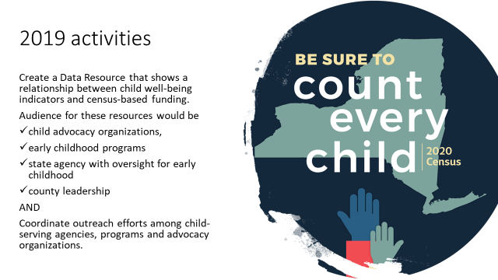
2019 activities
Create a Data Resource that shows a relationship between child well-being indicators and census-based funding.
Audience for these resources would be
child advocacy organizations,
early childhood programs
state agency with oversight for early childhood
county leadership
AND
Coordinate outreach efforts among child-serving agencies, programs and advocacy organizations.
Notes:
In 2019, the Council plans to develop a county resource on child well-being that shows a relationship to child well-being measures and census-based funding. Our targeted audience for the data resource will be advocates, early childhood programs, state agencies with oversight for early childhood and, of course, county leadership (e.g., county executives, etc.).
We continue to attend and present at community forums and professional development conferences on the undercount of children and how to start your local complete count committee.

Slide 10
2020 Census Advocacy in California
Stacy Lee
Managing Director Early Childhood Project Integration Children Now

Slide 11
We are an umbrella research, policy development, communications, and advocacy organization working on all key kids issues, including early childhood, education reform, children’s health, and child welfare.

Slide 12
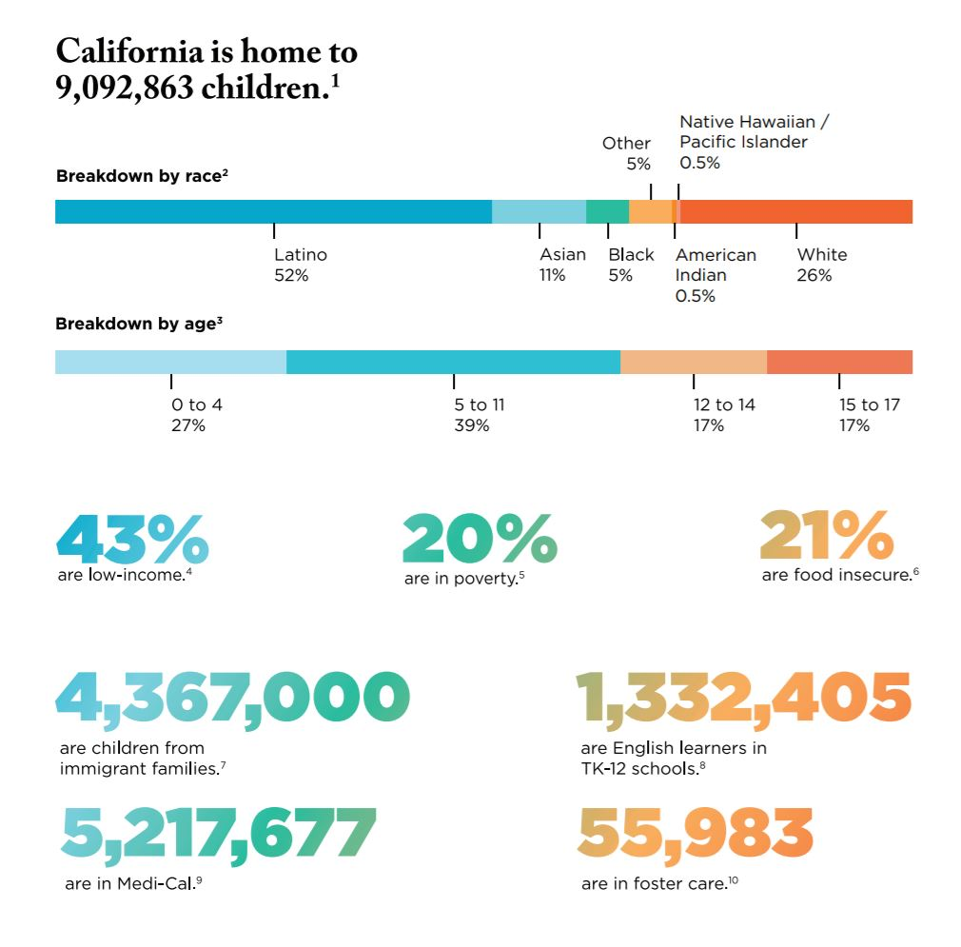

Slide 14
19 statewide/national organizations reflecting hard to count (HTC) populations: ethnic/racial communities including Native American, housing advocates, disability rights, LGBTQ, immigrant rights and advocates for children.
State Advocacy & Planning
Coordination with state government, philanthropy and coalition partners
State Complete Count Committee Appointees
Monitor implementation of state funding, engage State Census office
State Budget advocacy
2017-18 $10 million; 2018-19 $90 million over two years
Governor’s 2019-20 budget includes additional $54 million
Local Engagement & Planning
Coordination with local government agencies (county and city), philanthropy and CBOs
Local LUCA training/engagement support to verify addresses
Educate and engage networks about policy, trainings and opportunities to support
Notes:
$26.9 million to cbo’s of the 90 million… Covered CA spent $100m on marketing alone in one year
35 counties opted into state funding and are designated “complete count” counties
Funding supports CBO’s and administration, outreach and planning for counties
RFQ was posted for CBO intermediaries and are currently being reviewed
Held one round of regional hearings, planning additional this year.
Proposed 54 million
Regional ACBO contracts: Augment by $10 million for a total of $32.9 million
Statewide CBO contracts: Augment by $5.9 million for a total of $10 million
Funding for County Offices of Education (outreach to Title I and Title III schools): Augment by $1 million for a total of $1.7 million
Funding for outreach by the healthcare sector: Allocate $500,000
Funding for outreach by “other sectors” (e.g., unions, faith-based communities, business, technology, entertainment, rural communities): Augment by $500,000 for a total of $1.3 million
Media contracts: Augment by $30 million for a total of $46.1 million
Administration costs: Augment by $2 million for a total of $14.1 million

Slide 15
Engaging inside expertise/access in Sacramento
Amplifying messages via work across children’s policy areas
Leveraging the 3000+ members of The Children’s Movement through specific campaigns
Citizenship Question
Link to Annie E. Casey Foundation KIDS COUNT network
2018 KIDS COUNT Data Book foreword on 2020 Census undercount

Slide 16
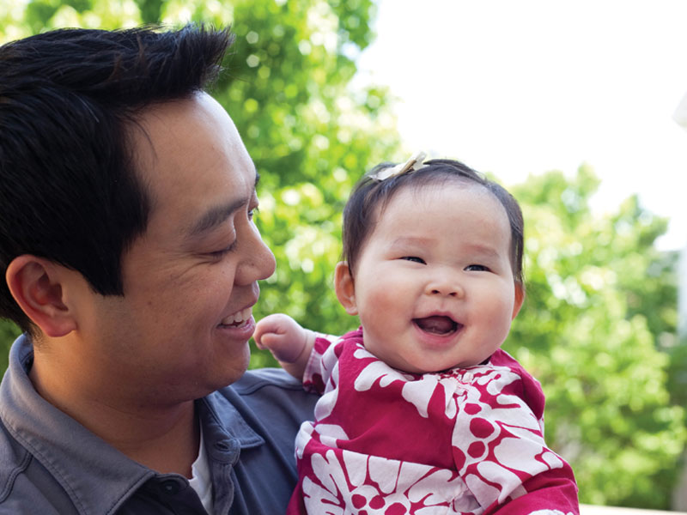
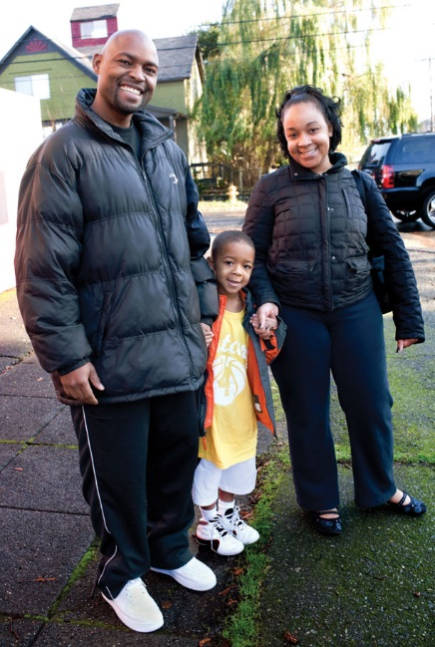
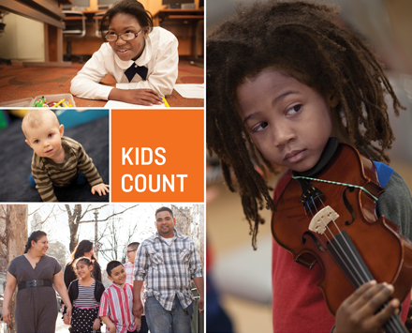
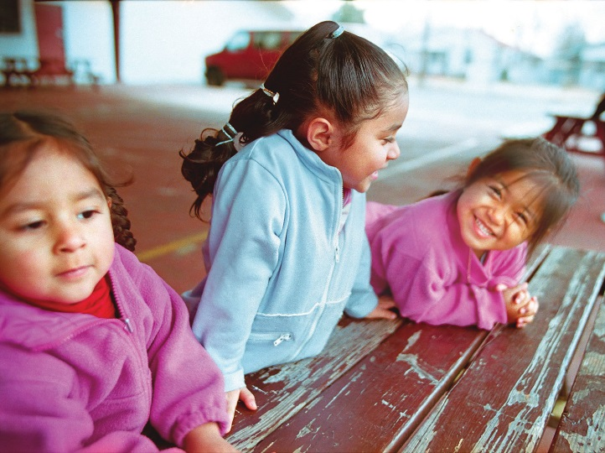
North Carolina Census 2020 Coordinating Efforts
Whitney Tucker, MPH | Research Director | NC Child
whitney@ncchild.org

Slide 17
About NC Child
NC Child builds a strong North Carolina by advancing public policies to ensure all children – regardless of race, ethnicity, or place of birth – have the opportunity to achieve their full potential.
www.ncchild.org | NC CHILD| 17
Notes:
NC Child speaks up for the needs of children and youth in halls of the state legislature, at the Governor’s mansion, and wherever policymakers are making important decisions about the future of our children and our state.

Slide 18
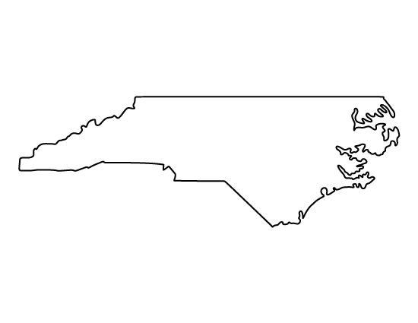
In the last census, North Carolina failed to enumerate thousands of young children.
If they had all been counted, the state would have gained an additional seat in Congress.
We have approximately 73,000 young children living in hard-to-count areas now.
www.ncchild.org | NC CHILD| 18
Notes:
NC is a state with many hard-to-count communities, in large part due to the rampant poverty in the state. 46% of kids in NC live under 200% FPL, and 21% under 100% FPL.
In addition to that, research has shown that urban and larger counties tend to have higher undercount rates of young children. That holds up for the most part in North Carolina.
Based on the latest estimates, about 10% of North Carolina’s current population lives in hard-to-count neighborhoods, and in Wake County (Raleigh) in 2010, there was an undercount rate for young children of 6.3%; in Mecklenburg County (Charlotte) it was 5.3%...in Durham, however, only 1.7%
Figuring out what went right – and wrong – with the count of young kids in Census 2010 is going to be key to a successful overall count in 2020

Slide 19
North Carolina receives more than $16 billion in federal funding based on the census – over $5 billion of that is designated for children’s services.
In 2000, an undercount led to inadequate funding for CHIP. Eligible children were put on a waiting list and went uninsured until additional funding was secured.
Child-Serving Program in North Carolina | Fiscal Year 2015 Dollars
Medicaid (Children's Portion Only) | $1.9 billion
Supplemental Nutrition Assistance Program (SNAP) (Children's Portion Only) | $1 billion
Title I Grants to Local Education Agencies | $416 million
National School Lunch Program | $375 million
Special Education Grants (IDEA) | $327 million
State Children's Health Insurance Program (S-SCHIP) | $395 million
Head Start/ Early Head Start | $212 million
Supplemental Nutrition Program for Women, Infants, and Children (WIC) | $193 million
Foster Care (Title IV-E) | $70 million
Child Care and Development Fund (CCDF) Entitlement | $122 million
www.ncchild.org | NC CHILD| 19
Notes:
A total of just over $16 billion comes to North Carolina based on the Census count, and more than $5 billion of that funding is directly attributed to services for children.
If missed in the Census, kids in hard to count communities also stand to suffer the most from reductions in funding to vital programs.

Slide 20
In-person meetings with Governor’s Office staff
Staggered phone calls from NC Census Task Force
Sharing fact sheets & blog posts
Establishing the Commission
The NC state Complete Count Commission was established in October 2018 by executive order.
Our coalition pushed for the appointments of diverse early childhood voices, using a variety of “soft” advocacy methods.
www.ncchild.org | NC CHILD| 20
Notes:
We really focused here on behind-the-scenes advocacy, wanting to push the Governor to establish a Commission but also wanting to avoid seeming to “shame” him into appointing early childhood advocates.
We emphasized often that young children were missed in the past and that it had a negative effect on state funding and (to this particular administration) on congressional representation. And then proposed folks who work on children’s issues as those whose perspectives could be particularly helpful in overcoming that challenge.
The NC Complete Count Commission now has 3 early childhood advocates – myself, the communications director of NC Partnership for Children, and the president and CEO of Albemarle Alliance for Children and Families, a local child and family services organization.

Slide 21
Encouraging Progress
NC Counts Coalition
Convening local stakeholders
University Students
Capstone Project completing necessary research
Grant-Funded Resources
Focusing on young children since most available materials don’t
The Commission is now well-established with its own website and an NC Census logo, but its work remains unfunded.
NC Child has been working with partners to creatively move forward despite state-level limitations.
www.ncchild.org | NC CHILD| 21
Notes:
As the state Complete Count Commission gets it footing and tries to determine an (as yet) unfunded outreach strategy, the NC Census Task Force comprised of NC Child, NALEO, and the NC Counts Coalition have worked to keep Census 2020 in the forefront of community leaders’ minds
A couple of weeks ago, NC Counts Coalition held a statewide convening of state and national speakers on the census, which was attended by about 200 potential advocates for a complete count, including a large number of state employees
NC Child has enlisted graduate students from the University of North Carolina to conduct statewide mapping of local Complete Count Committees, their leading organization type (faith-based, government, or nonprofit), and contact information so that the Commission can coordinate efforts with those groups
In addition to those efforts, NC Child has published fact sheets, blog and social media posts, and an issue brief on the young child undercount that is now being shared through my involvement in the state Complete Count Commission – there hasn’t been any coordinated work yet, so materials that are already complete are shared enthusiastically, because folks are clamoring for content and to be asked to do something

Slide 22
Primary Messages
NC Child’s Census 2020 priority now is securing state funding for complete count efforts.
Last year, the Governor’s request of $1.5 million was rejected by the legislature
Current messaging to various groups has focused on different aspects of the young child undercount
Legislative Staff – Other states’ funding levels; historic undercount
Early Childhood Advocates – Program funding at stake in undercount
County/Municipal Governments – Hard-to-count populations and population growth that could go unaccounted for
www.ncchild.org | NC CHILD| 22
Notes:
Newly-elected legislators present opportunity

Slide 23
NC Complete Count Commission – official state Census strategists
www.census.NC.gov
NC Child – resource on all things N.C. kids
Count All Kids – national info on young kids & Census 2020
www.NCchild.org
www.countallkids.org
www.ncchild.org | NC CHILD| 23
Notes:
Here’s a quick cheat sheet to help you learn more about the Census, its impact on young children, and what you can do to help prevent an undercount
The state’s Complete Count Commission already has a website up with lots of information to help you get started in advocating for the Census in your community: census.NC.gov
Beyond that, NC Child will also be releasing materials. We already have a few fact sheets: one that includes some of the information shared today on the young child undercount, and another about how exactly the Census count translates into funds for North Carolina programs. Both are available on our website at www.ncchild.org

Slide 25
Ohio Census Advocacy Coalition
Executive Committee
Steering Committee
Work Groups
Communication
Local Outreach
Local Advocacy
State Advocacy
Federal Advocacy
2020 Census Overview
Notes:
We launched the Ohio Census Advocacy Coalition in early 2017
We have our executive committee where we are driving the work
Our work groups, communication, local outreach, and state, local, and federal advocacy. To help advance the work
And our executive committee the driving force beyond the work and in many instances the true sweat equity
We have a variety of stakeholders involved representing hard to count communities, advocacy organizations, local government leaders, philanthropy, and more

Slide 26
Advocacy (State & Local)
Goals:
State funding for census efforts (Introduction in Governor’s Budget)
State Complete Count Commission
State infrastructure for future census counts
Strategy:
Early communications with new cabinet members
Aligned agenda and messaging amongst partner organizations
Tiered funding suggestions
2020 Census Overview
Notes:
We’ve worked with our coalition partners to develop a state budget ask and inform Ohio’s new executive leaders as they compose the first budget from Ohio’s new governor.
Our ask came out before the fabulous new tool from the leadership conference to help you determine the funding your state needs.
Our ask was $2.5 M
We went for what we thought would be a strong start for a state with no real history for investing state dollars in the census
There was no investment in 2000 or 2010
We broke our ask into 3 tiers
Tier 1 - $625,000 to support staffing and administration for the state CCC, which has not yet been formed
(Ohio’s gubernatorial election always falls in the years when state’s should be developing their CCCs and the political environment either prevents the CCC from being formed or places its work in a questionable political light.
A large portion of this funding also supports some initial work in HTCs.
Tier 2 - $1.2 M to support staffing and communications as well as supplemental outreach across the state with a focus on census tracts with a Low Response Score at or between 20.0 and 49.1.
Tier 3 - $ 2.5 M supports additional outreach and mini-grants to support outreach and communications in HTC
We’ve move the ball forward by through
Some strong relationship building and early meetings with new members of the governor's cabinet
We’ve worked to get the messaging and ask onto the agenda of a number of key coalitions and associations
include an alliance of the mayors of Ohio’s 30 largest cities, which was helpful in connecting with a key cabinet member, a former mayor, who invited us to submit information as they developed their agency’s budget ask
As well as other influential groups including our children’s budget coalition, key early education partners, and human service groups

Slide 27
Census Solutions Workshops
20-25 Community Leaders
Statewide Representation
Training in Design Thinking Facilitation
Development of Critical Insights
Danger of a 2020 Census Undercount!
Notes:
We lead the OCAC Communication efforts
In order to engage key communities and gather insights we can use in later communication and outreach efforts we are bring together leaders from around the state to have the host their own Census Solutions Workshops
You may recall from the Kids Count Institute last fall information about Census Solutions Workshops. These are design thinking ideation sessions deigned to engage communities and generate ideas for overcoming challenges to census participation using the design thinking facilitation and ideation approach.
We’ve worked with the census bureau and a host of other local partners to identity high risk census tracts and influential community leader who could host a Census Solutions Workshop in their area and really bring out members of their communities.
We’re wrapping up the registration process and will bring all of them to Columbus next month to train them on the census and design thinking and send them back to their communities to host a workshop in the weeks following the training
We’re also working with a communications firm to narrow be sure we gather the insights important to inform the messaging tools we plan to put together

Slide 28
Questions? | Thank You!
Ashon McKenzie, Esq. Policy Director
Children’s Defense Fund-Ohio
amckenzie@childrensdefense.org
Next Webinar Session
Notes:
We’re really excited about this work as well as a number of other initiatives we are moving forward on
But I’ll pause here to say thank you for the opportunity to share today

Slide 29
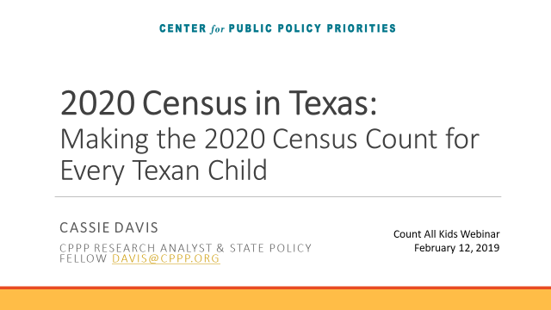
2020 Census in Texas: Making the 2020 Census Count for Every Texan Child
Cassie davis
CPPP Research analyst & State Policy Fellow davis@cppp.org
Count All Kids Webinar February 12, 2019

Slide 30
Why the 2020 Census Matters to Texas
Notes:
Representation:
Texas could gain up to 3 additional seats in congress
Foundation for redistricting at all levels in government
Federal $
Conservative messaging: An incomplete, inaccurate 2020 Census would result in a lost decade of federal resources Texans have been paying into and deserve to benefit from.
Business:
Business friendly state
state and local government agencies, nonprofit organizations, and businesses will make countless policy and investment decisions that depend on the reliability and accuracy of census data

Slide 32
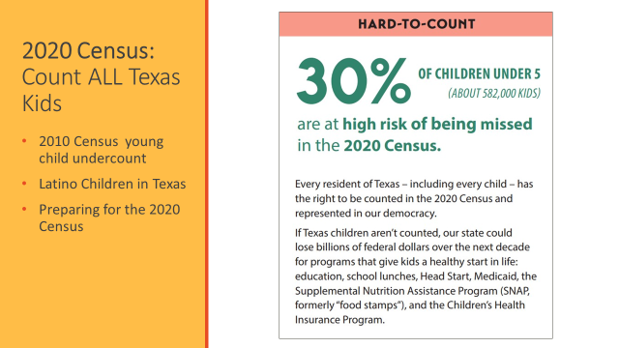
2020 Census: Count ALL Texas Kids
2010 Census young child undercount
Latino Children in Texas
Preparing for the 2020 Census
Notes:
In the 2010 Census, 7.4% (about 155,000) of children under 5 in Texas were missed
Texas has a high Latino population almost half of the young children missed were Latino:
Texas missed seven percent of young Latino children—about 75,000—age four or younger
Latino children are twice more likely to be undercounted than non-Hispanic White children
Dallas and Harris County, the net undercount of young Latino children was some of the highest across the nation in 2010.
2020 Census
30% of children under 5 at risk of being missed in the 2020 Census
Majority of Texas children live in metro areas—as seen w/ research the largest the county the higher the risk of under count
Currently 50% of our children 0-4 are Latino in Texas
Latino Children in Texas are overrepresented in high poverty neighborhoods
2.8 million (25 percent) Texas children live in families with at least one non-citizen parent and even more live with immigrant family members.

Slide 33
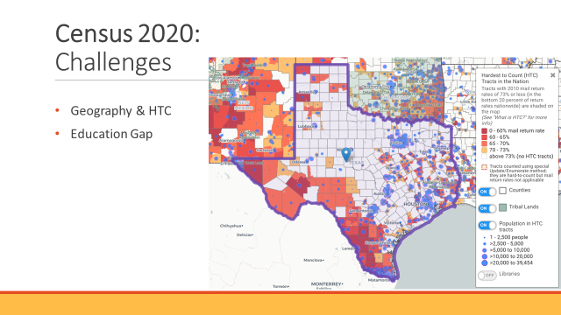
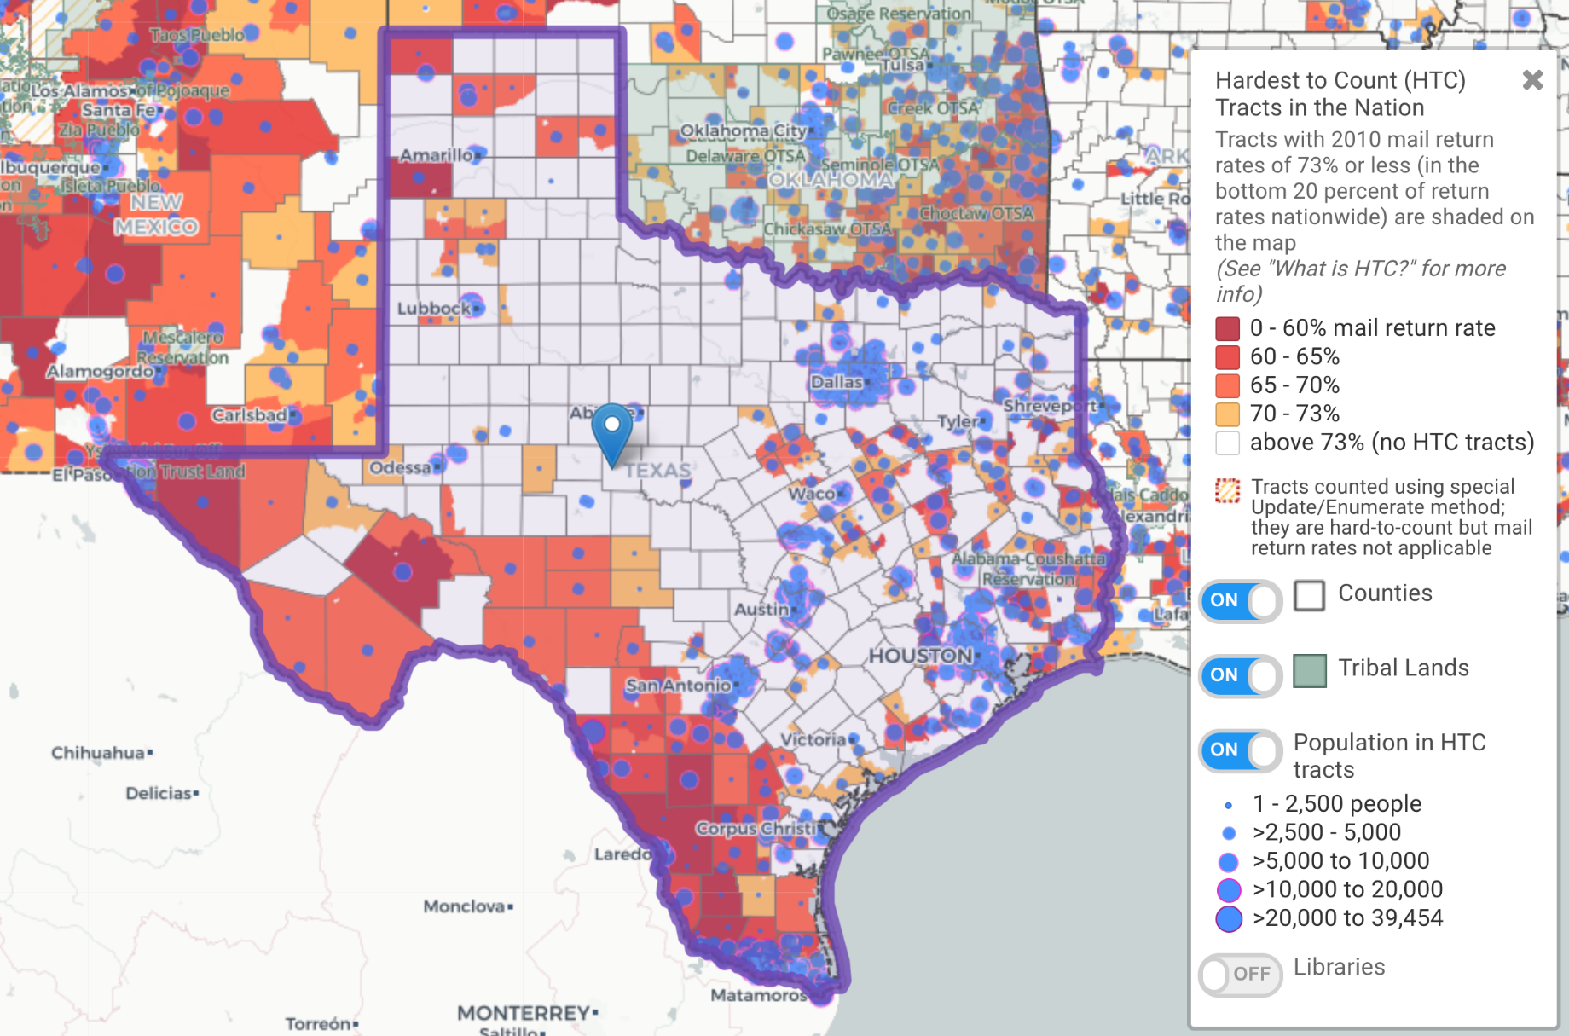
Census 2020: Challenges
Geography & HTC
Education Gap
Notes:
Geography & HTC: Texas is one of the largest states and regional different so one message/strategy may not be the solution for another area
State Strategy: Conservative state in which we have seen reentrancy around the Census given the Citizenship Question
Education: 2020 Census education gap– some, NOT all are learning why the state and local communities need to support the census and an accurate count

Slide 34
Census 2020: Texas Sized Solutions
Funding
Local Communities Committed
CPPP & Texans Care For Children
Notes:
State CCC
HB 255, Rep. Blanco
establishes a statewide CCC
Creates a robust 2020 Census outreach plan
Grant program: governor to administer available funds or private donations and award local grants to local governments for outreach efforts
Funding:
Conservative state so asking for 5-10 million in hopes we will get some $
Have testified at Finance and appropriations hearings to advocate for $ from the state
Local CCCs & outreach
36 local CCC’s according to Census Bureau– missing contact information for most
San Antonio, Houston, Austin/Travis, Dallas, El Paso, and Rio Grande Valley (Hidalgo County leading)
San Antonio: started work in 2018: held stakeholder interviews over the summer for feedback on how to achieve a complete count; participated in LUCA, working closely with the Census Bureau, will have a subcommittee on young children
Rio Grande Valley—Hidalgo County: Efforts being led by County Judge Garcia→ have community & Buisness buy-in
2010 had an experience of CB not delivering to PO BOX, which is hard for Colonia residents (colonia is an unincorporated living area with substandard housing lacking in basic services such as potable water, electricity, paved roads, proper drainage, and waste management.)
LUCA: submitted 16,000 corrected addresses and 15,000 new address → over 100,000 more residents accounted for
CCC organized into subcommittees→ education subcommittee, have ISDs committed to printing and give flyers to families
National message vs. tailored: took control of their message and had a logo contest to have one united message
CPPP & Texans Care Grant
Work to identify children under 5 are especially if they are in HTC areas
Texans care works with early childhood centers in these areas
Develop resources to share directly with families at early childhood centers to educate them on the importance of the Census and counting their very young children.

Slide 35
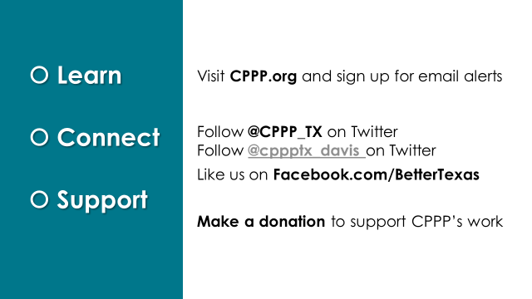
Learn
Connect
Support
Visit CPPP.org and sign up for email alerts
Follow @CPPP_TX on Twitter
Follow @cppptx_davis on Twitter
Like us on Facebook.com/BetterTexas
Make a donation to support CPPP’s work

Slide 36
We believe in a Texas
that offers everyone the chance to compete and succeed in life.
We envision a Texas
where everyone is healthy, well-educated, and financially secure.
@CPPP_TX

Slide 37
Next Webinar February 20
• Amy Swann, Kentucky Youth Advocates: activities undertaken in the absence of any funding
• Denise Tanata, Children's Advocacy Alliance (Nevada): shaping the work of a state Complete Count Committee
• Amber Wallin, New Mexico Voices for Children: building support for state and non-profit CCC’s in resistant environments and building support among philanthropic foundations
• Margaret Nimmo Holland, Voices for Virginia's Children: using local data to identify where kids may be missed, working with community foundations and local government associations

Slide 38
Questions?
For more information about the young child undercount, visit www.countallkids.org
Register for Part 2 here: https://cc.readytalk.com/r/wkdhhpumtd9e&eom
And Part 3 here:
https://cc.readytalk.com/r/5pu3ad3jrtn3&eom

