Slide 1
2020 CENSUS:
LET ALL OUR PEOPLE BE COUNTED

Slide 2
2020 Census Faith Council Members
The 2020 Census Faith Council has two major goals:
Engage in strategic advocacy
Play a lead role in mobilizing hard-to-count communities within their respective networks
African-American Ministers Leadership Council
African Methodist Episcopal Church
Catholic Legal Immigration Network
Church of God In Christ
Conference of National Black Churches
Faith in Public Life
Jewish Community Relations Council NY
Jewish Council for Public Affairs
Muslim Public Affairs Council (MPAC)
National Association of Catholic Diocesan Directors of Hispanic Ministry
National Baptist Convention USA
National Council of Churches
National Latino Evangelical Coalition
Network Lobby for Catholic Social Justice
Poligon National
Progressive National Baptist Convention
Samuel DeWitt Proctor Conference
Shepherding the Next Generation
Skinner Leadership Institute
Sojourners

Slide 3
Census Ambassadors: Things you can do
Faith in Public Life, in partnership with the 2020 Census Faith Council, will recruit 1,000 Faith Census Ambassadors nationwide, with a particular focus in hard to count communities.
While the Faith Council will be national faith organizations, these Ambassadors will be prominent clergy and faith leaders able to influence their local communities.
Here’s what it means to be a Faith Census Ambassador:
Participate in FPL’s 3-part training on how to ensure a fair and accurate Census (done by webinar).
Recruit 3 more Faith Census Ambassadors in key locations.
Speak at public events about the Census and the importance of being counted.
Distribute flyers and the Faith Census Tool-kit to key leaders in your community.
Join quarterly conference calls to stay informed.

Slide 4
Additional Resources:
More information can be found at www.FaithInPublicLife.org/Census and www.CensusCounts.org
The Hard to Count Map shows which Census tracts had the lowest response rates: www.censushardtocountmaps2020.us
Faith Census Ambassadors: Get more information and sign up here: www.FaithInPublicLife.org/Census
Spanish version is here: bit.ly/2020espanol
Census Demographics in Hard to Count Tracts

Slide 5
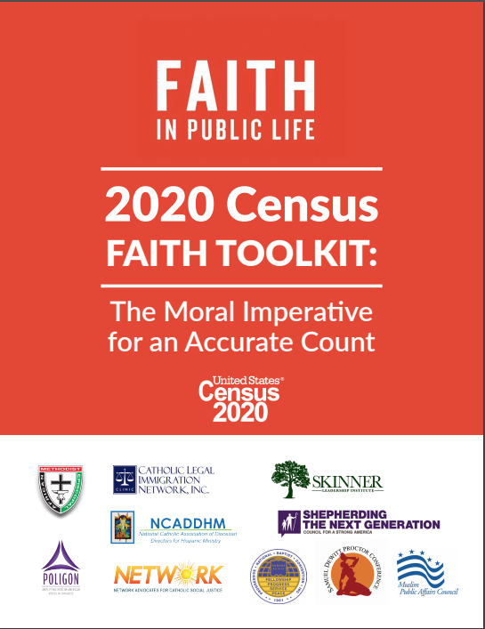
2020 Census Faith Toolkit

Slide 6
Contact Information:
Sara Benitez, Organizing Director - sbenitez@faithinpubliclife.org
Ben Brown, Program Associate - bbrown@faithinpubliclife.org

