Slide 1
Texas Counts Campaign: CBO Webinar logistics
Audio available over computer speakers or call: 866.740.1260; Access Code: 3200106
During Q&A:
We will have your lines on mute during the presentation
If you have a question, use the chat box on the left side of your screen and we’ll address as soon as we can
During the report out period:
If you have a question, use the chat box on the left side of your screen and we’ll address as soon as we can
Following the call, we will:
Include a link to the webinar recording when we send out the minutes from this meeting.
Notes:
Adrianna

Slide 2
Texas Counts Campaign
Sept CBO Subcommittee Mtg
Notes:
Adrianna welcomes on behalf of UWT, CPPP & Texas Counts Campaign Steering Committee

Slide 3
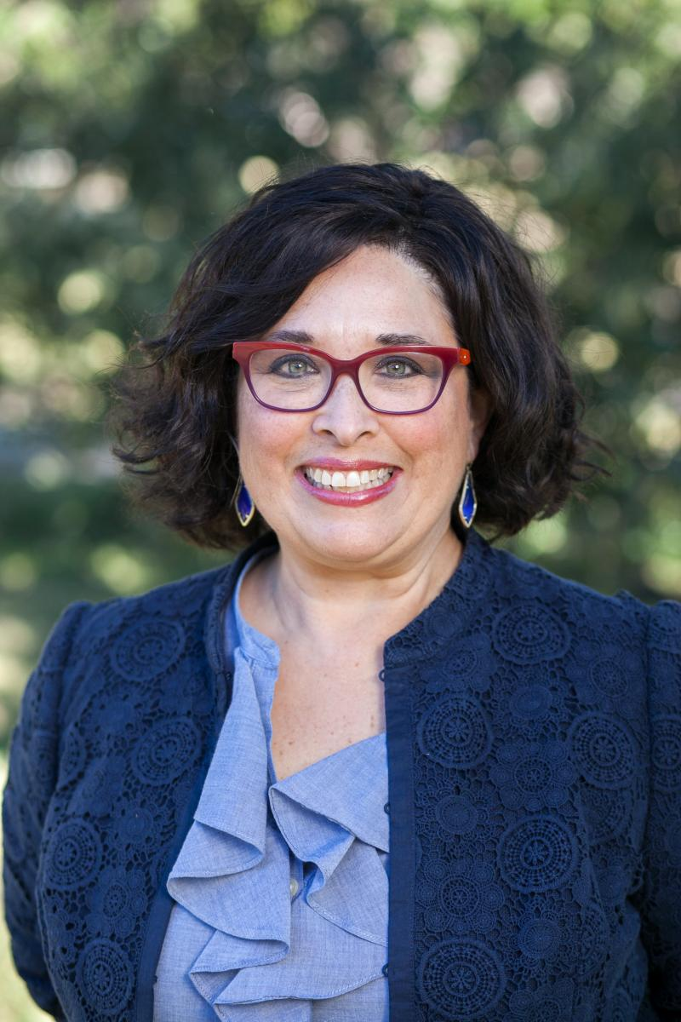
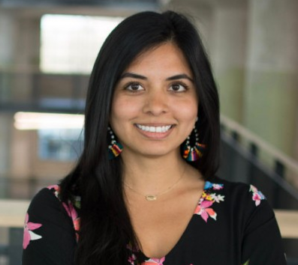
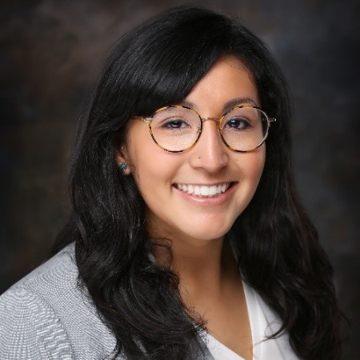
Voices on the Call Today . . .
Adrianna Cuellar Rojas
President & CEO
United Ways of Texas
Katie Martin Lightfoot
Census Comm. Engagement Coord.
CPPP
Cassie Davis
Research Analyst
CPPP
Notes:
Adrianna introduces Katie & Cassie

Slide 4
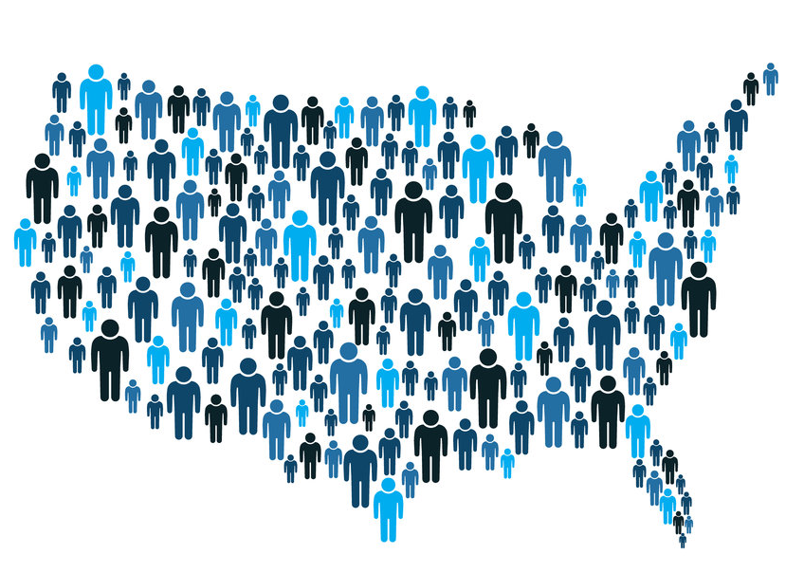
Agenda
Welcome & review agenda
Updates from the Campaign
Existing materials & what’s coming
CBO member updates
Next steps
Notes:
Adrianna reviews agenda

Slide 5
Updates from the Campaign
Notes:
Katie – give a little bit of background on your position and role going forward

Slide 6
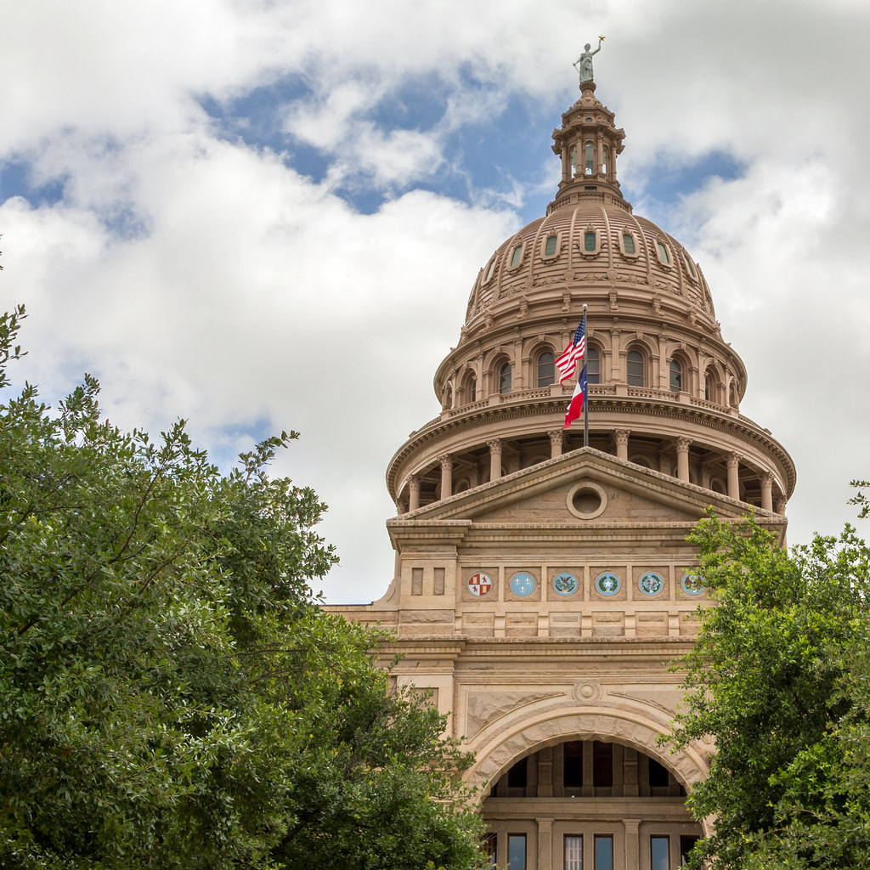
Where we started . . .
State government
Hope was that the state (Legislature or Governor) would step up
But alas . . . they didn't.
Notes:
Katie

Slide 7
Texas Counts Campaign
Government
Health
Faith
$
Philanthropy
Education
CBO
Business
Notes:
Katie

Slide 8
Texas Counts Campaign
Notes:
Katie

Slide 9
Texas Counts Campaign: CBO
Co-chair: United Ways of Texas
Co-chair: CPPP
Arise
Boat People SOS
Children’s Defense Fund Texas
Feeding Texas
JOLT
League of Women Voters of Texas
Meals on Wheels
NAACP
NALEO
Proyecto Juan Diego
RGV Equal Voices Network
Texans Care for Children
Texas AFL-CIO
Texas Alliance of Boys and Girls Clubs
Texas Assoc. of Community Action Agencies
Texas Association of Community Development Centers
Texas Association of Goodwills
WNA
+23 Additional orgs w/ interest
Notes:
Katie

Slide 10
Notes:
Katie

Slide 11
Where we are now: Campaign & Pooled Fund
Notes:
Katie

Slide 12
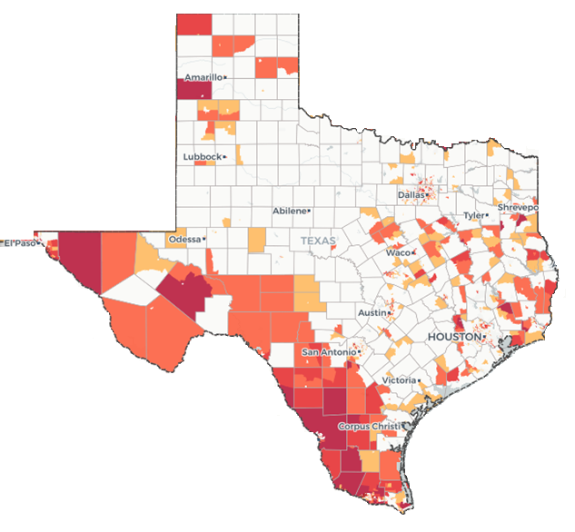
Where we’re going . . . Three strategies
https://www.censushardtocountmaps2020.us/
Notes:
Katie discuss three strategies:
1) Supporting your efforts and those of your local partners with resources and connections
2) Targeting HTC areas, asking you for help reaching those communities
3) Pooled fund

Slide 13
Q&A
Notes:
Cassie answer questions. Katie, monitor and ask questions that pop up over the chat function.

Slide 14
What do we have to help you now?
Notes:
Katie pass it over to Cassie to discuss materials/ resources we have available. Cassie, introduce yourself to the members and describe role.

Slide 15
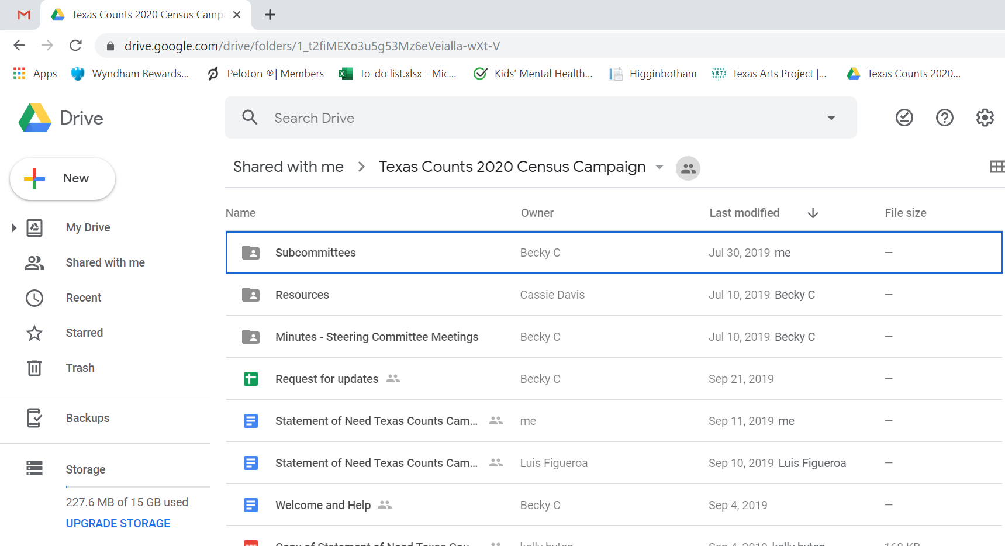
Notes:
Cassie

Slide 16
Notes:
Cassie

Slide 17
Notes:
Cassie

Slide 18
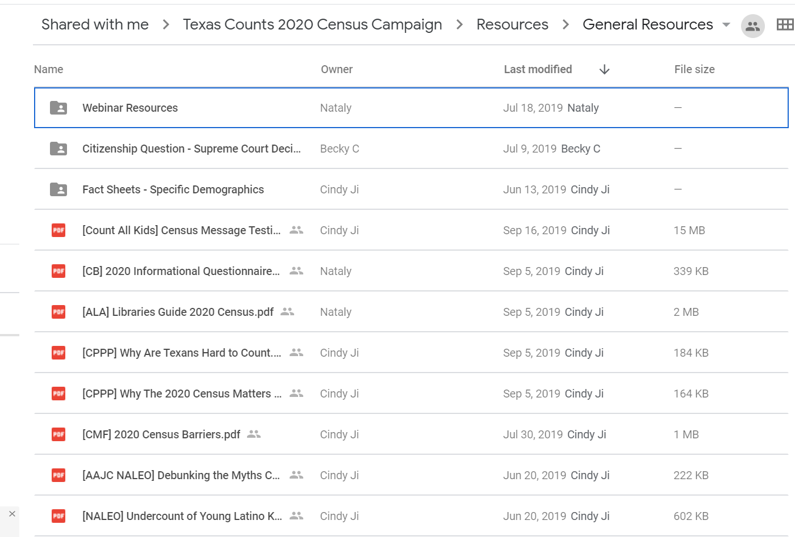
Notes:
Cassie

Slide 19
Sample 2020 Census Questionnaire (Paper version)
Notes:
Cassie

Slide 20
Notes:
Cassie

Slide 21
Notes:
Cassie

Slide 22
Notes:
Cassie

Slide 23
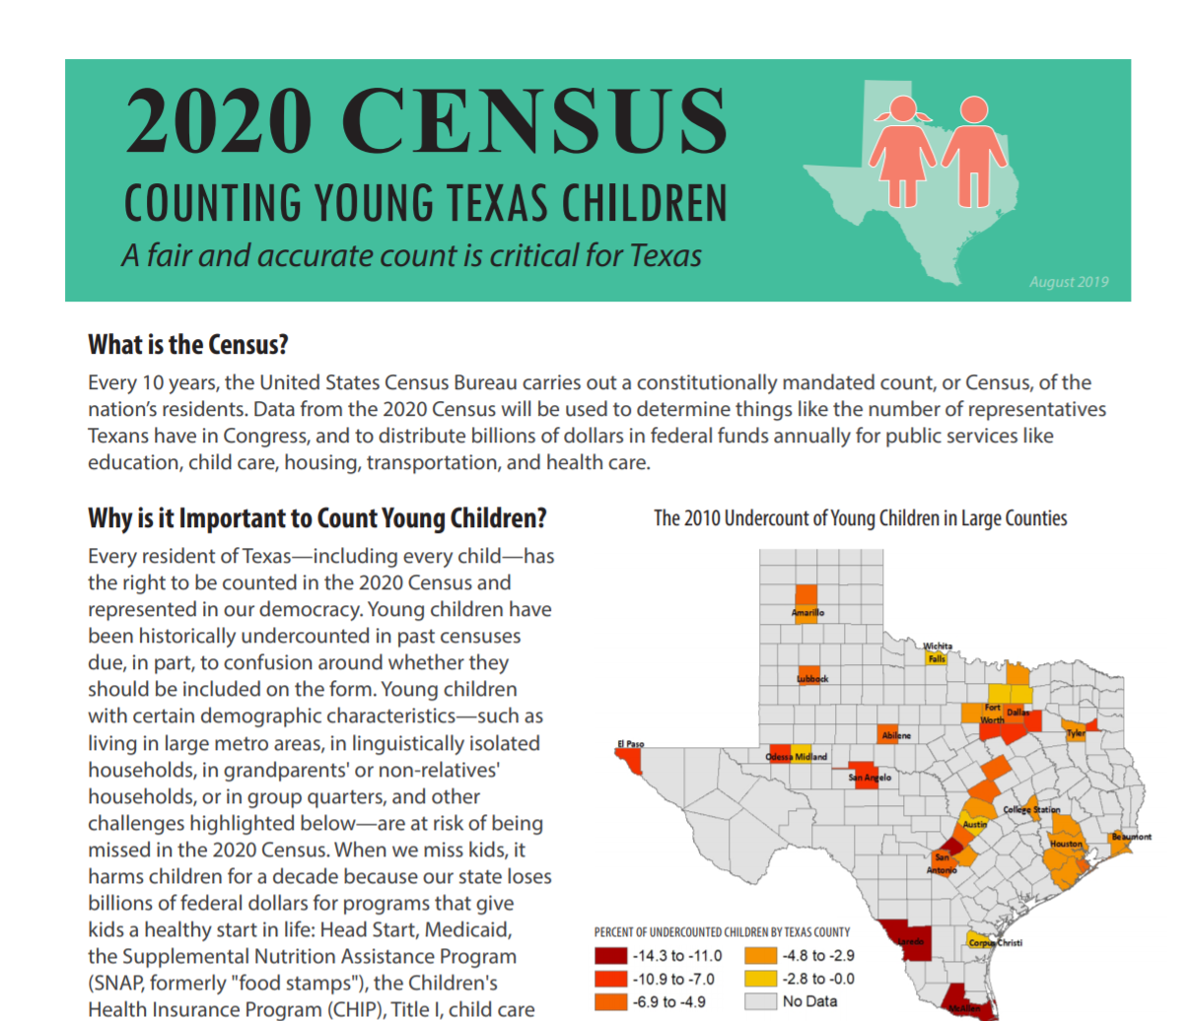
Notes:
Cassie

Slide 24
Notes:
Cassie

Slide 25
Notes:
Cassie

Slide 26
Notes:
Cassie

Slide 27
Notes:
Cassie

Slide 28
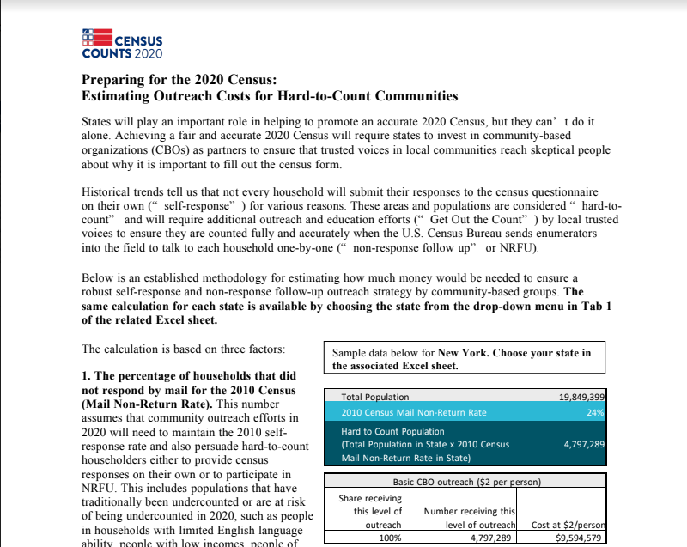
Notes:
Cassie

Slide 29
Notes:
Cassie

Slide 30
What’s in the queue
Texas Counts Campaign
1-pager (updated)
Talking points & stock email
Webpage
Notes:
Cassie

Slide 31
What’s in the queue
Data Guide
What happened with the Citizenship Question?
FAQ: Counting Young Children
Toolkit for childcare providers
Notes:
Cassie

Slide 32
Q&A
Notes:
Cassie answer questions. Katie, monitor and ask questions that pop up over the chat function.

Slide 33
CBO Subcommittee: Updates and needs
What work have you been doing over the last month on the Census?
What barriers have you faced / questions have arisen while doing this work over the last month?
What do you need and how can we help?
Notes:
Adrianna – let them know that we use this information to identify needs for the CBO community to set content for future calls, identify resources needed, and report out to Steering Committee to find cross-sector commonalities.

Slide 34
Next Steps
Sending: Google Commitment Form, webinar recording & minutes
Upcoming meetings
October 29th @ 2:00 Central
CHANGE: November 19th @ 2:00 Central
Connect with us if you have questions or suggestions!
Notes:
Adrianna

